Slide 1
Chapter 9
Numerical Integration

Slide 2
Core Topics
(i) Rectangle and Midpoint Methods (9.2)
(ii) The Trapezoidal Method (9.3) (iii) Simpson’s Methods (9.4)
(iv) Gaussian Quadrature (9.5)
(v) Evaluation of Multiple Integrals (9.6)
(vi) Use of MATLAB built-in Functions for Integration (9.7)
(vii) Estimation of Error (9.8)
(viii) Richardson Extrapolation (9.9) (ix) Romberg Integration (9.10)
(x) Improper Integrals (9.11)

Slide 3
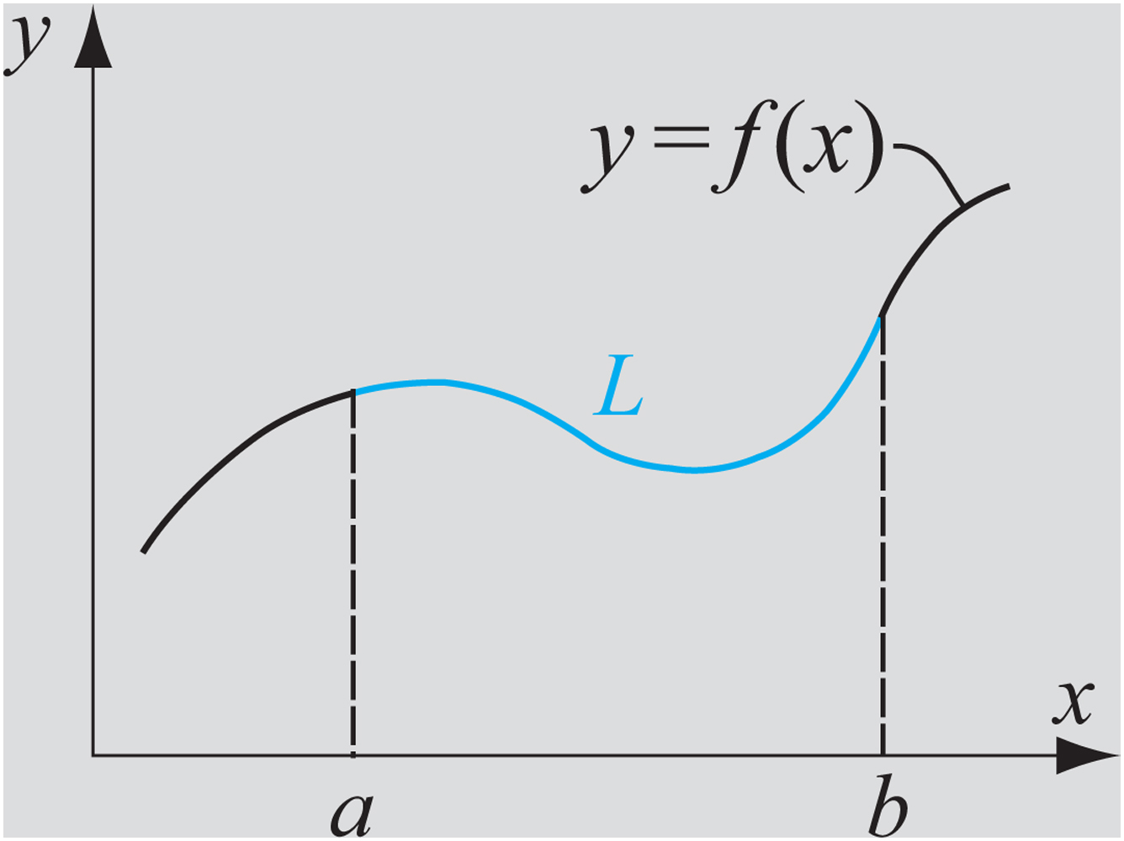
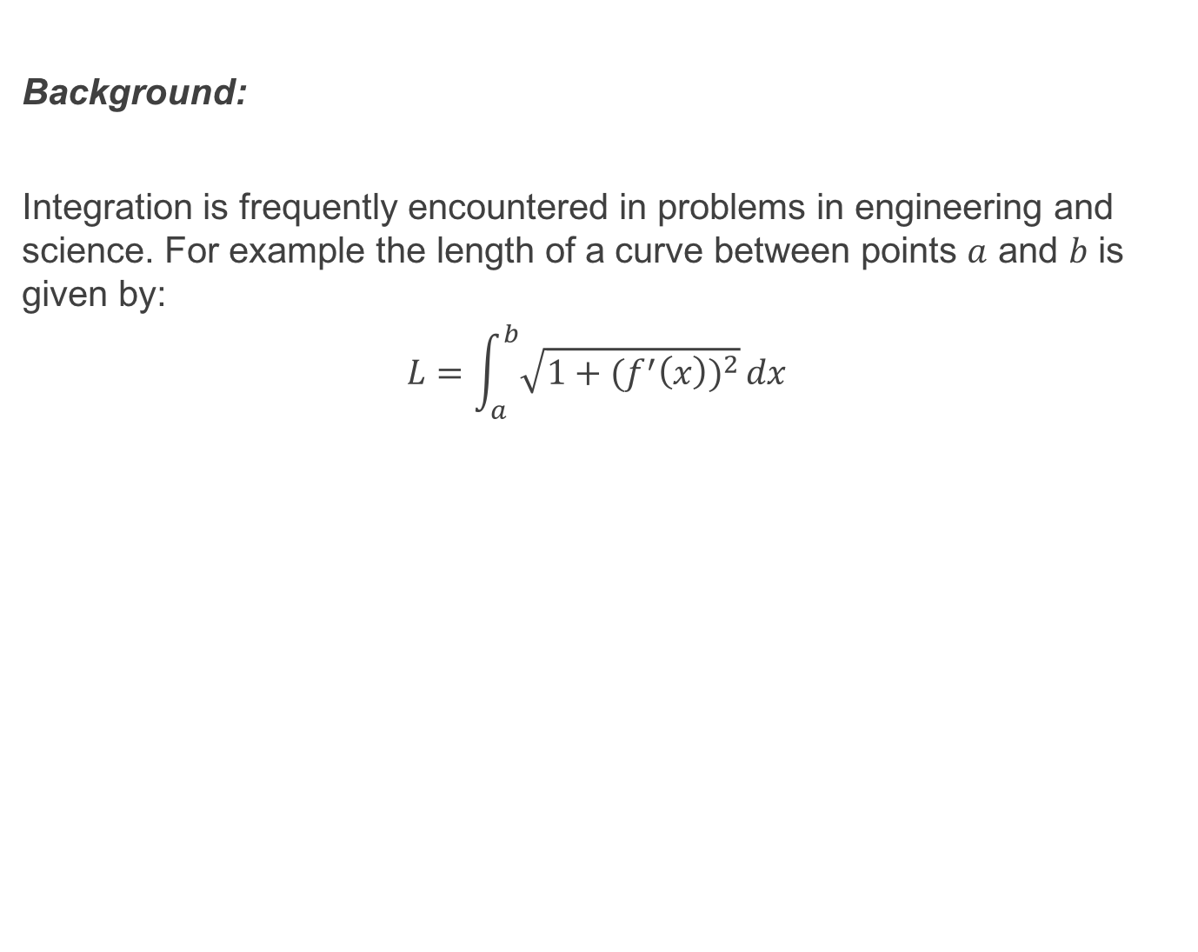
Background:
Integration is frequently encountered in problems in engineering and science. For example the length of a curve between points $a$ and $b$ is given by:
$$L=\int_{a}^{b}{\sqrt{1+{{(f}^{′}\left(x\right))}^{2}}}dx$$

Slide 4
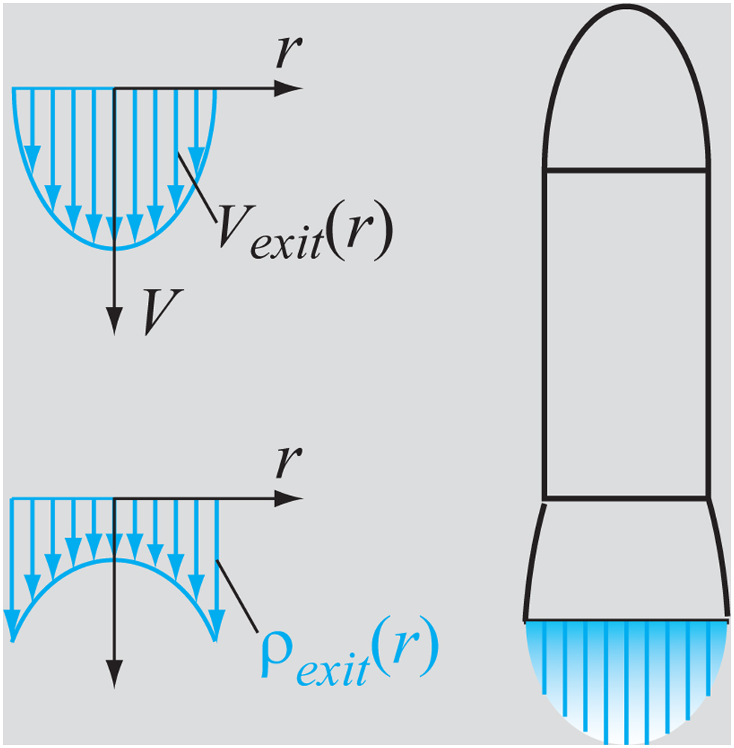
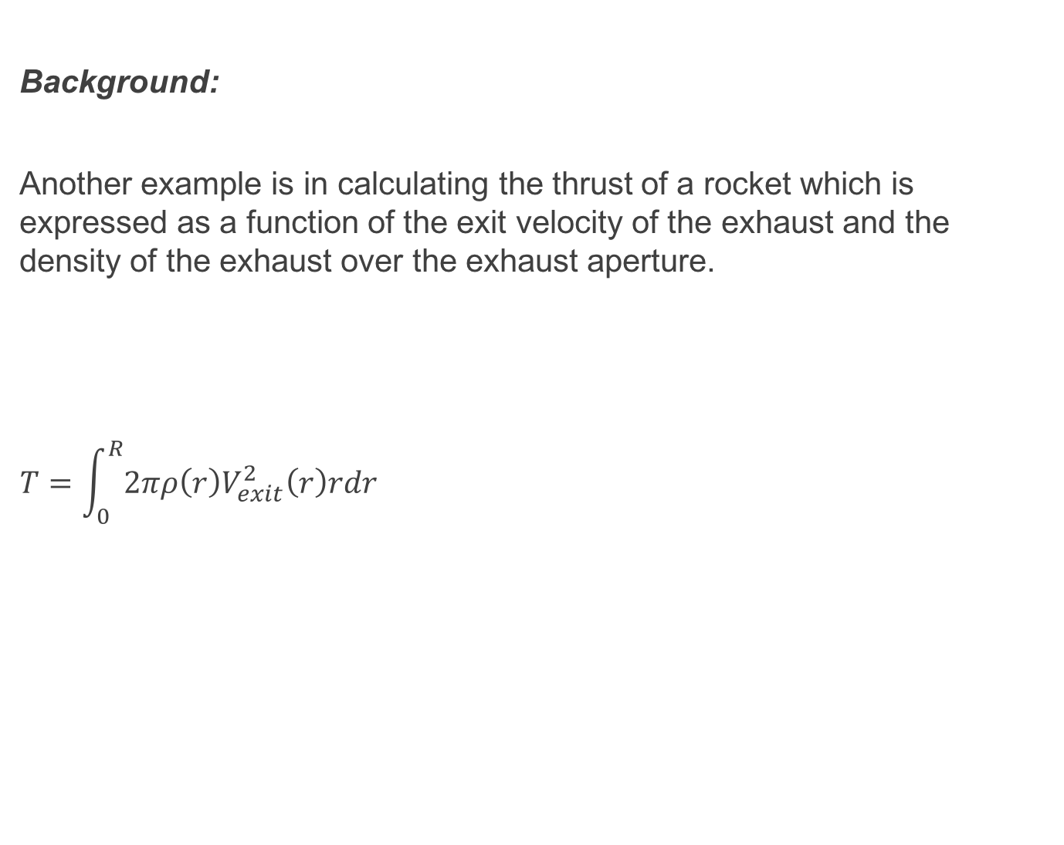
Background:
Another example is in calculating the thrust of a rocket which is expressed as a function of the exit velocity of the exhaust and the density of the exhaust over the exhaust aperture.
$$T=\int_{0}^{R}{2πρ\left(r\right)V_{exit}^{2}\left(r\right)rdr}$$

Slide 5
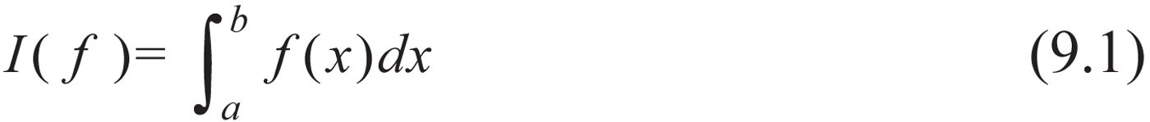
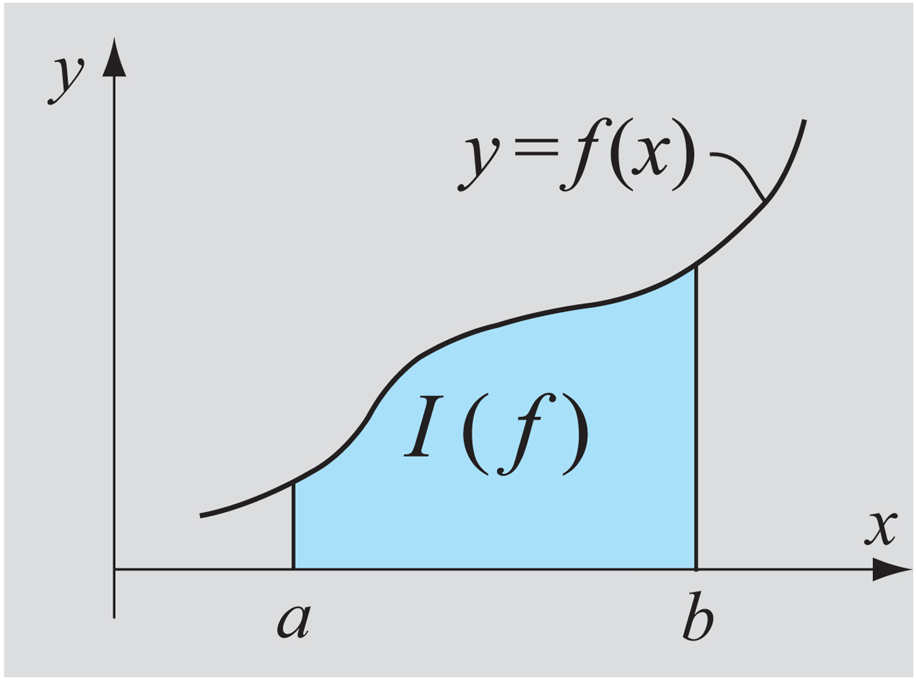
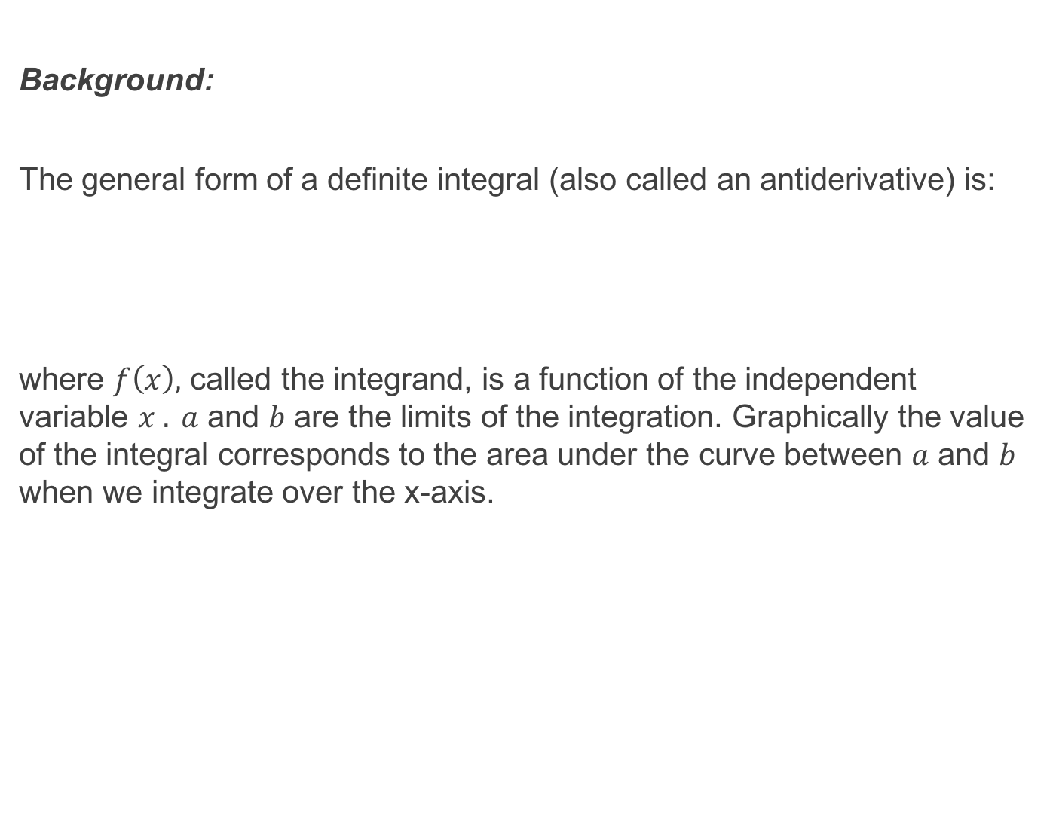
Background:
The general form of a definite integral (also called an antiderivative) is:
where $f\left(x\right),$ called the integrand, is a function of the independent variable $x . a$ and $b$ are the limits of the integration. Graphically the value of the integral corresponds to the area under the curve between $a$ and $b$ when we integrate over the x-axis.

Slide 6
Background:
The integrand can be an analytical function or a set of discrete points (tabulated data). Numerical integration is needed when the integrand is discrete and/or where analytical integration is difficult, numerous or impossible.

Slide 7
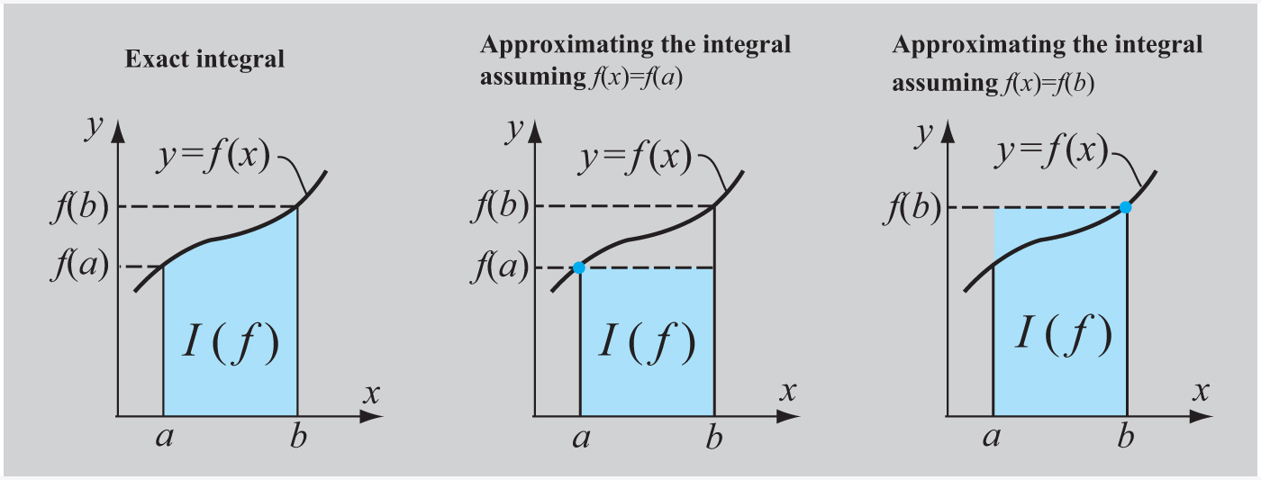
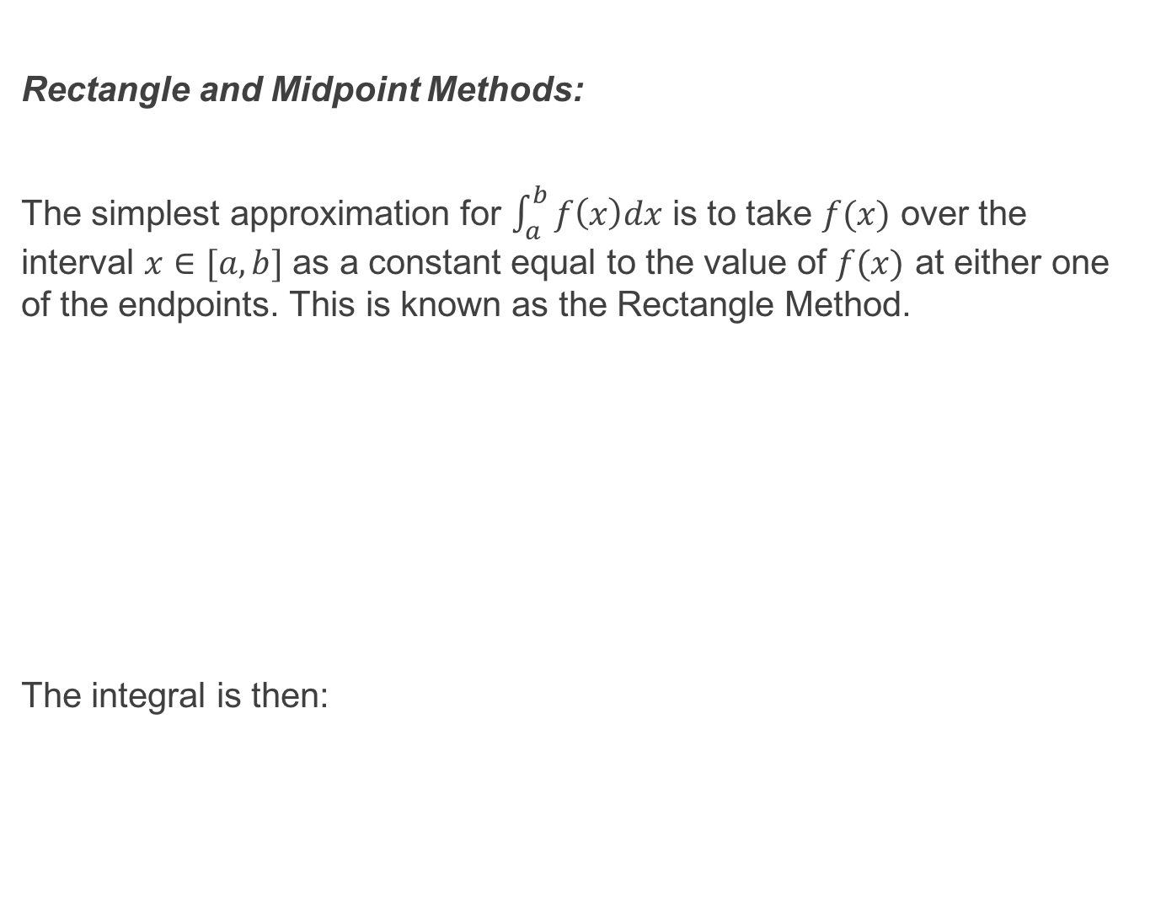
Rectangle and Midpoint Methods:
The simplest approximation for $\int_{a}^{b}{f\left(x\right)dx}$ is to take $f(x)$ over the interval $x∈[a, b]$ as a constant equal to the value of $f(x)$ at either one of the endpoints. This is known as the Rectangle Method.
The integral is then:

Slide 8
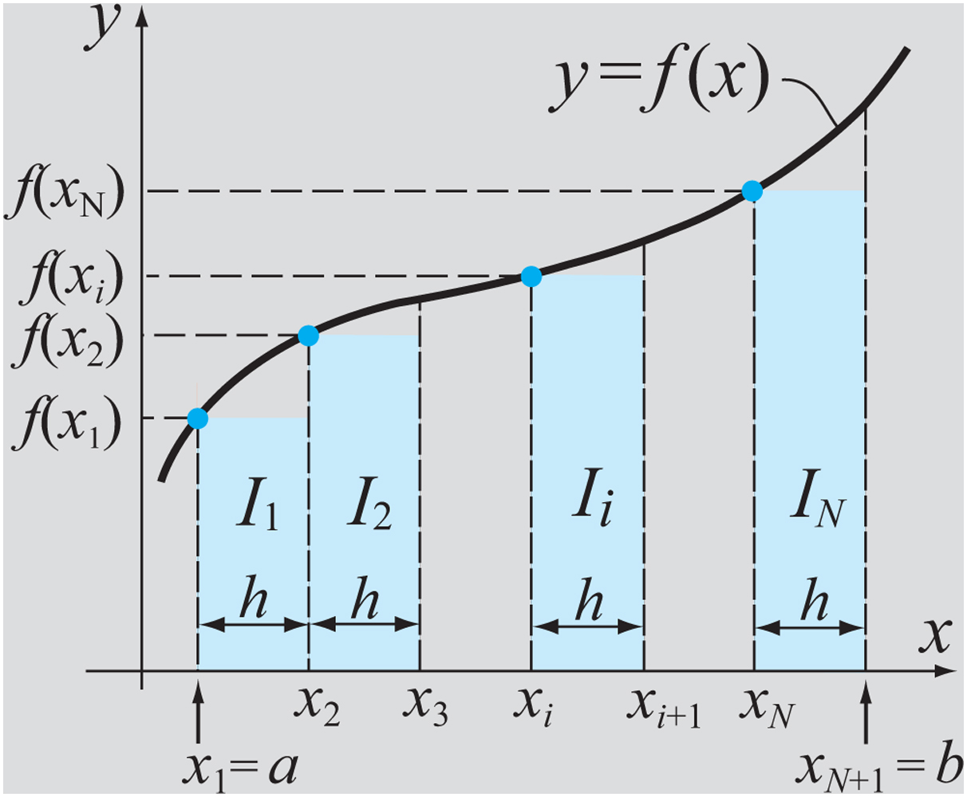
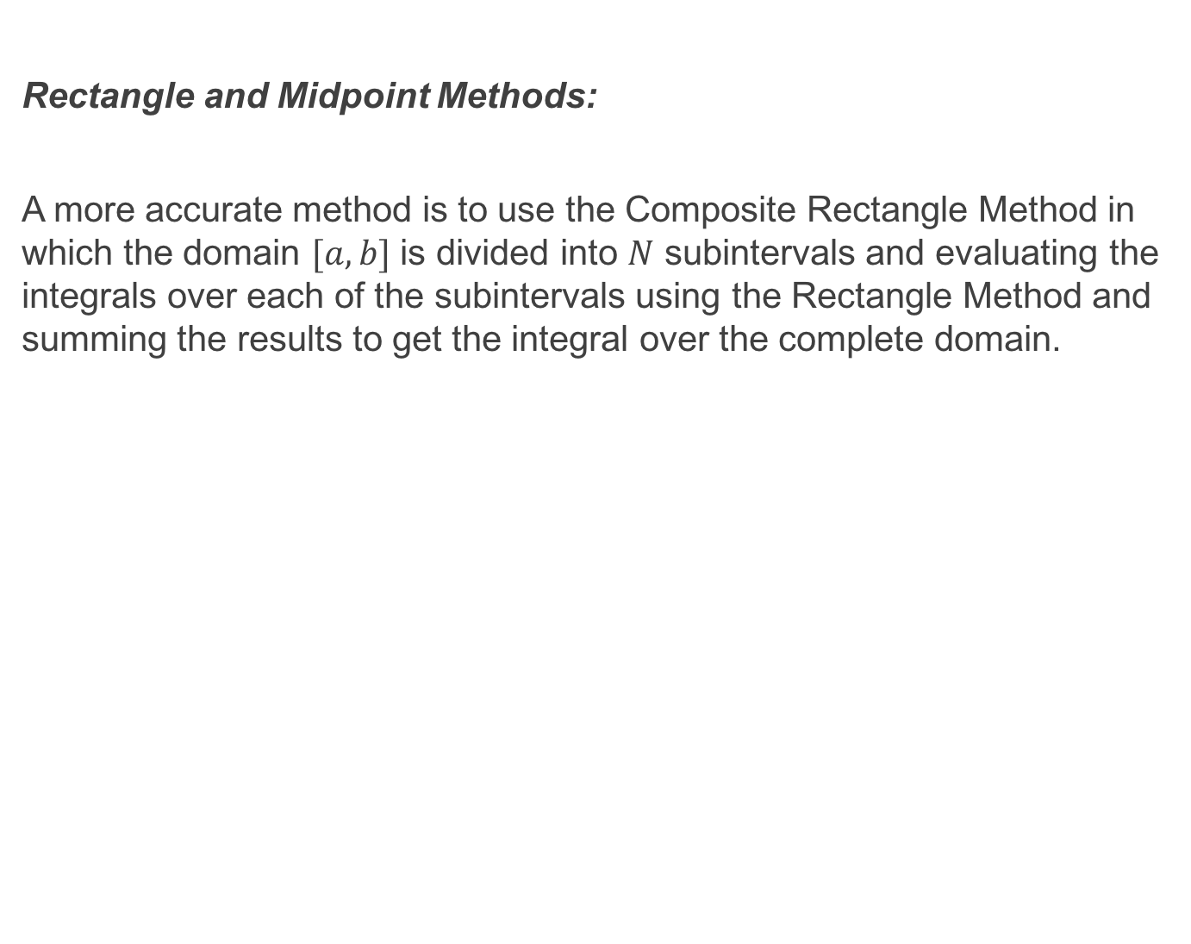
Rectangle and Midpoint Methods:
A more accurate method is to use the Composite Rectangle Method in which the domain $[a, b]$ is divided into $N$ subintervals and evaluating the integrals over each of the subintervals using the Rectangle Method and summing the results to get the integral over the complete domain.

Slide 9
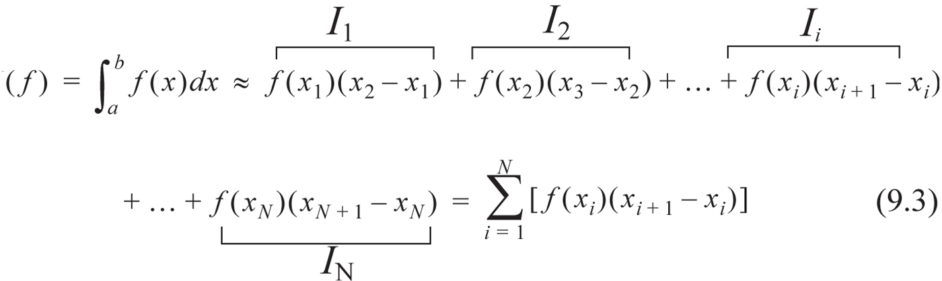
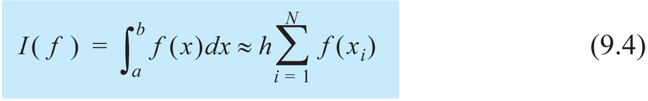
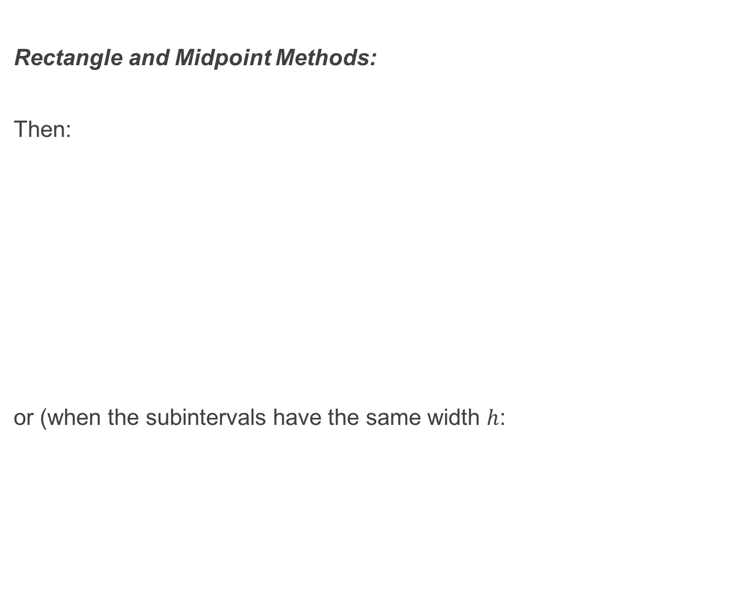
Rectangle and Midpoint Methods:
Then:
or (when the subintervals have the same width $h$:

Slide 10
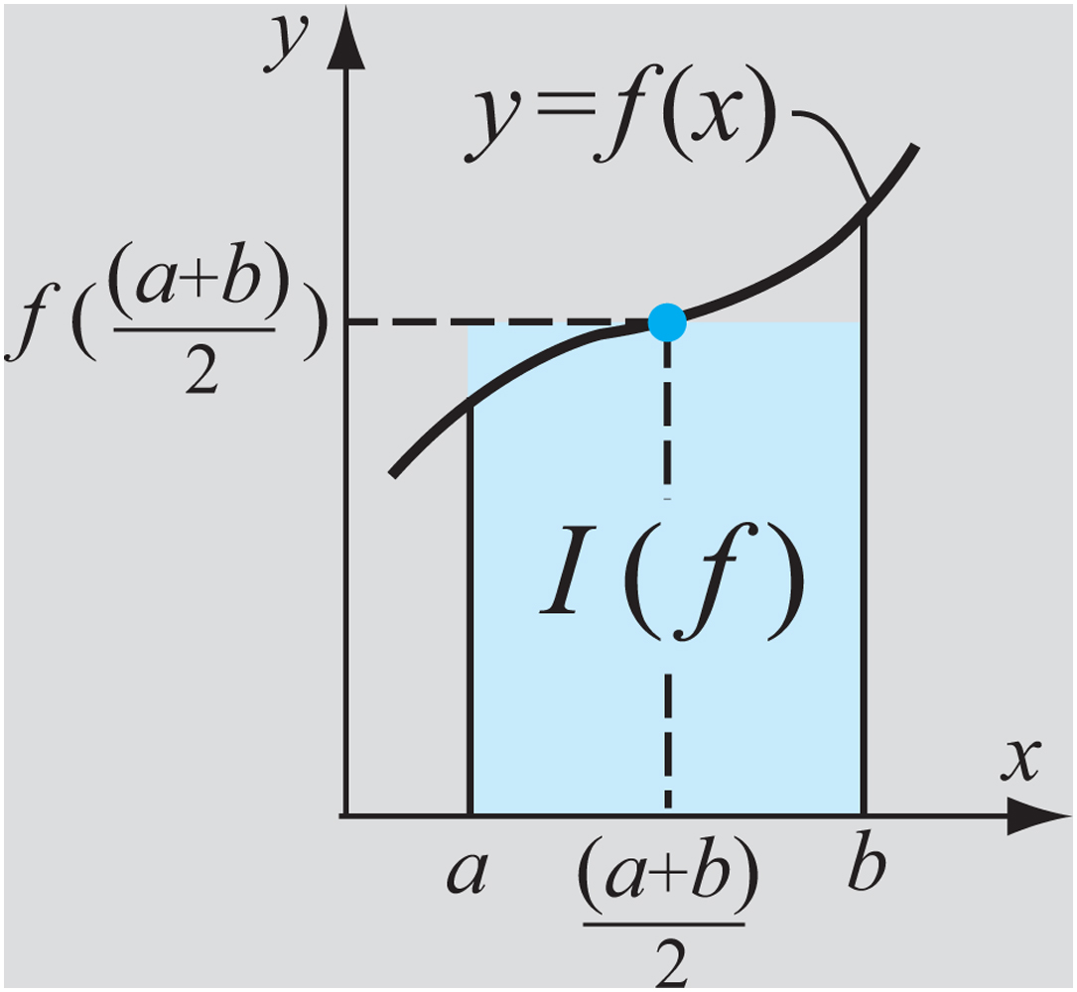
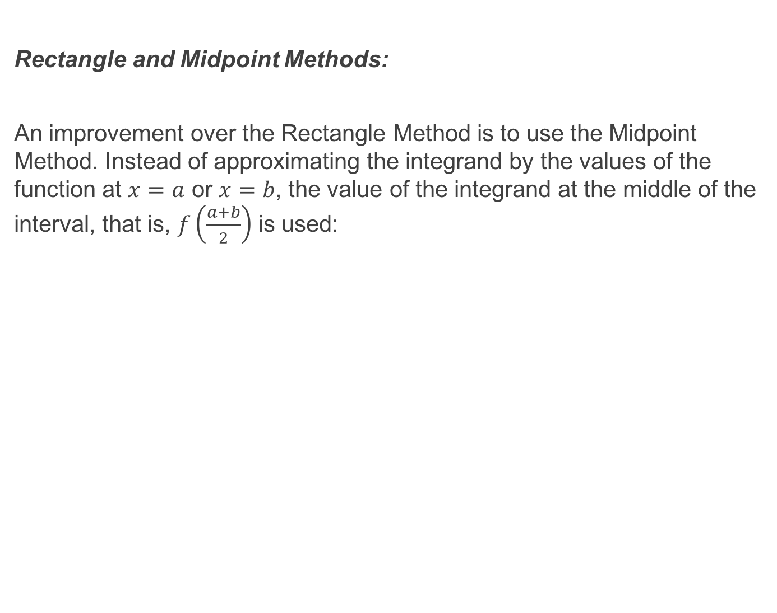
Rectangle and Midpoint Methods:
An improvement over the Rectangle Method is to use the Midpoint Method. Instead of approximating the integrand by the values of the function at $x=a$ or $x=b$, the value of the integrand at the middle of the interval, that is, $f\left(\frac{a+b}{2}\right)$ is used:

Slide 11
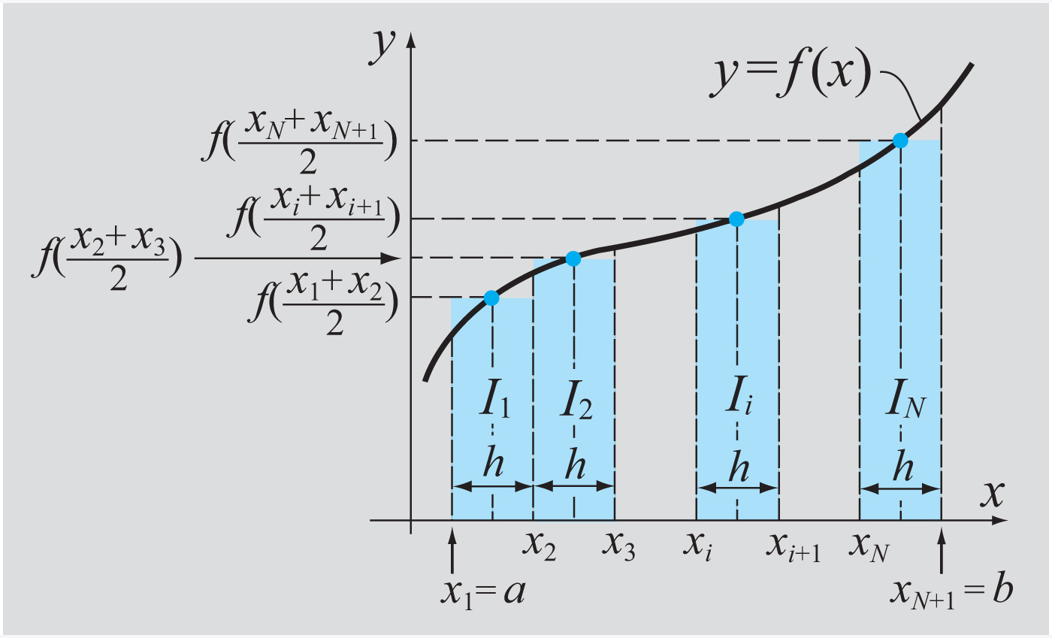
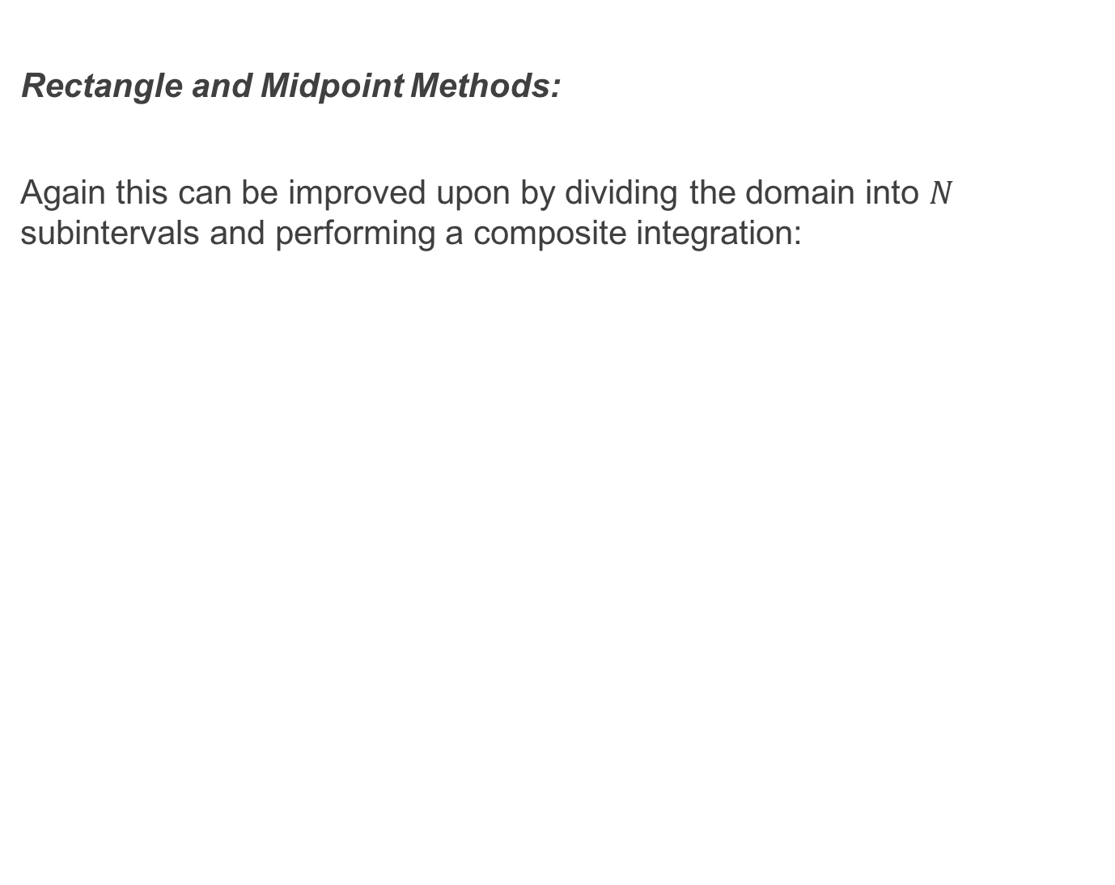
Rectangle and Midpoint Methods:
Again this can be improved upon by dividing the domain into $N$ subintervals and performing a composite integration:

Slide 12
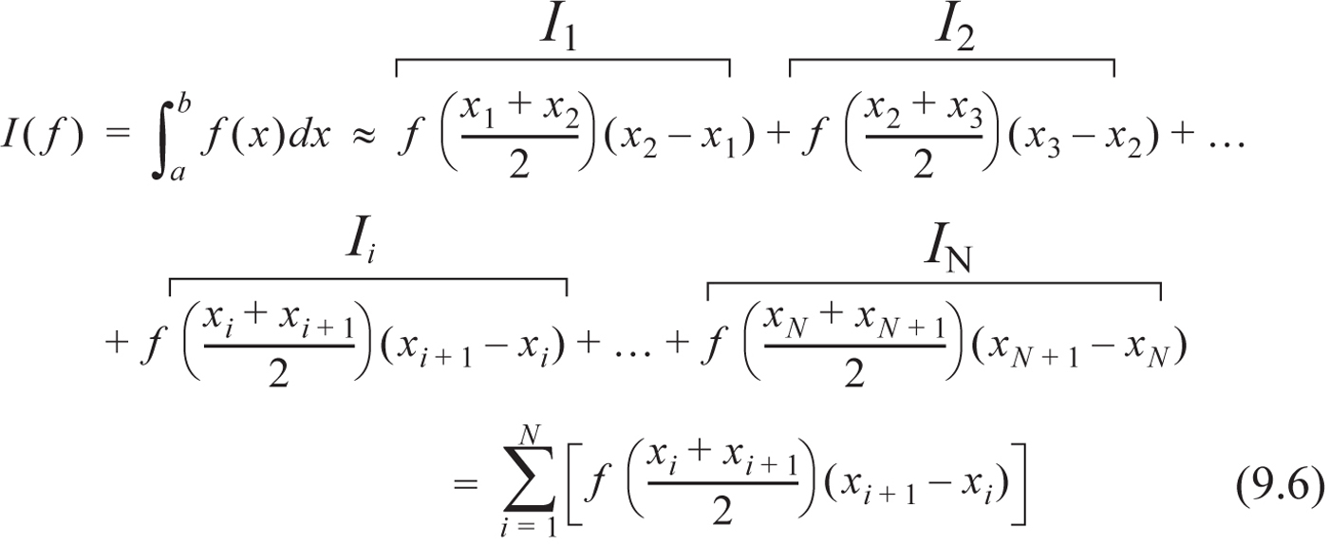
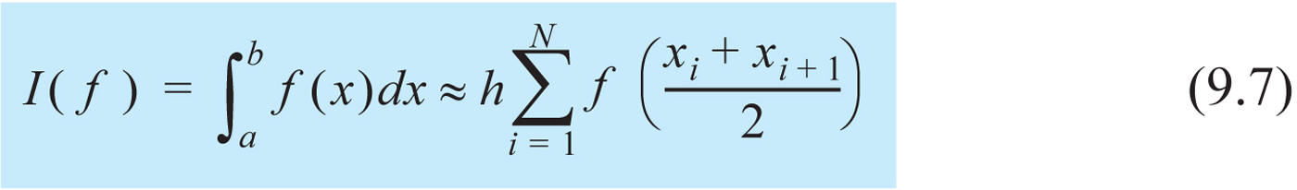
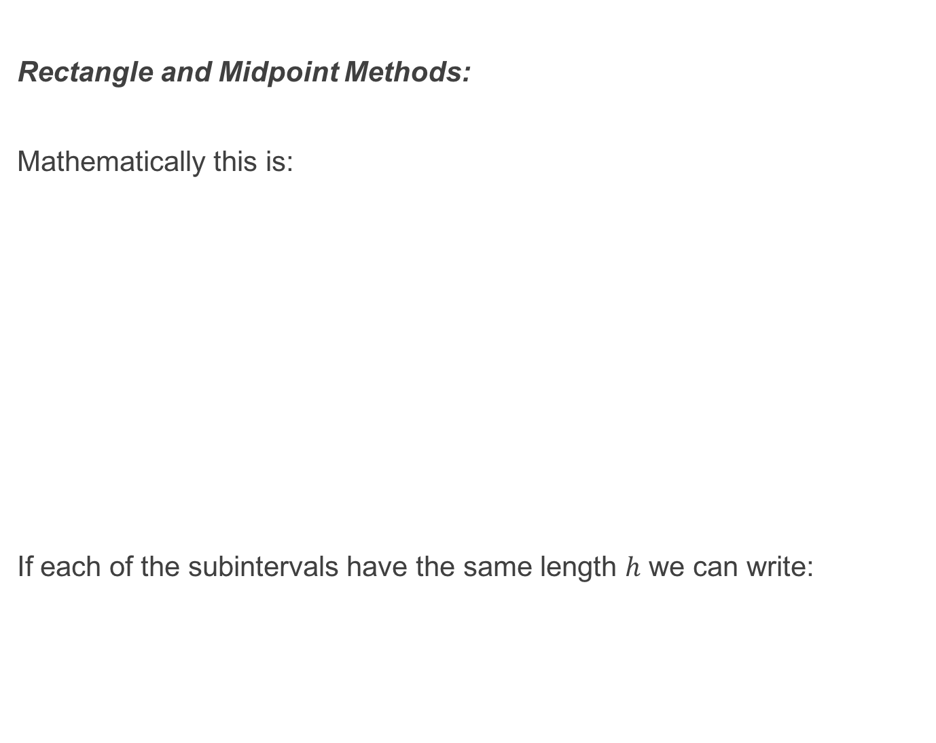
Rectangle and Midpoint Methods:
Mathematically this is:
If each of the subintervals have the same length $h$ we can write:

Slide 13
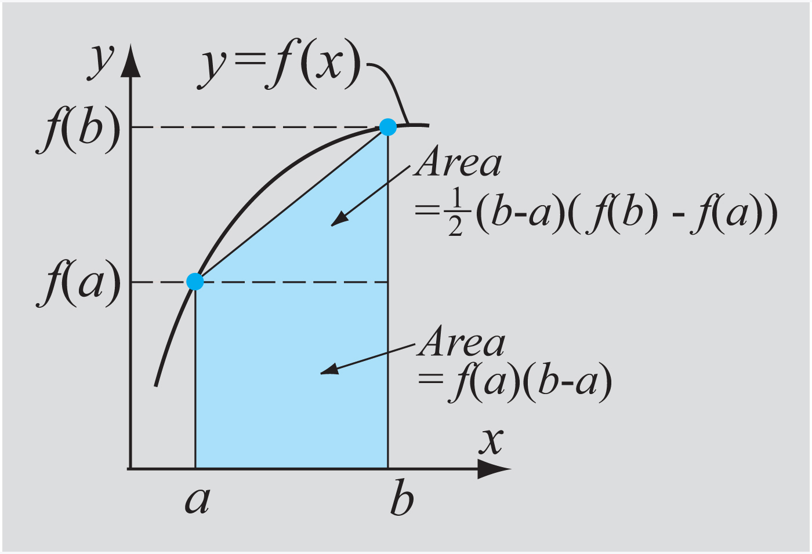
The Trapezoidal Method:
A refinement over the simple Rectangle and Midpoint Methods is to use a linear function to approximate the integrand over the interval of integration.

Slide 14
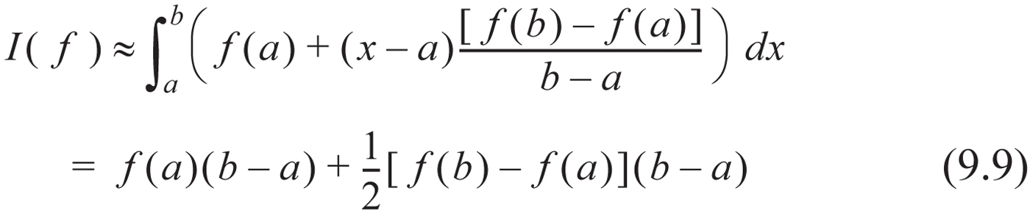
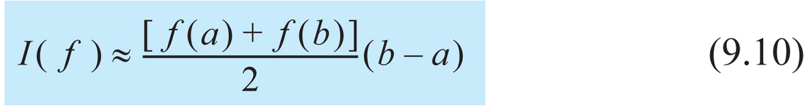
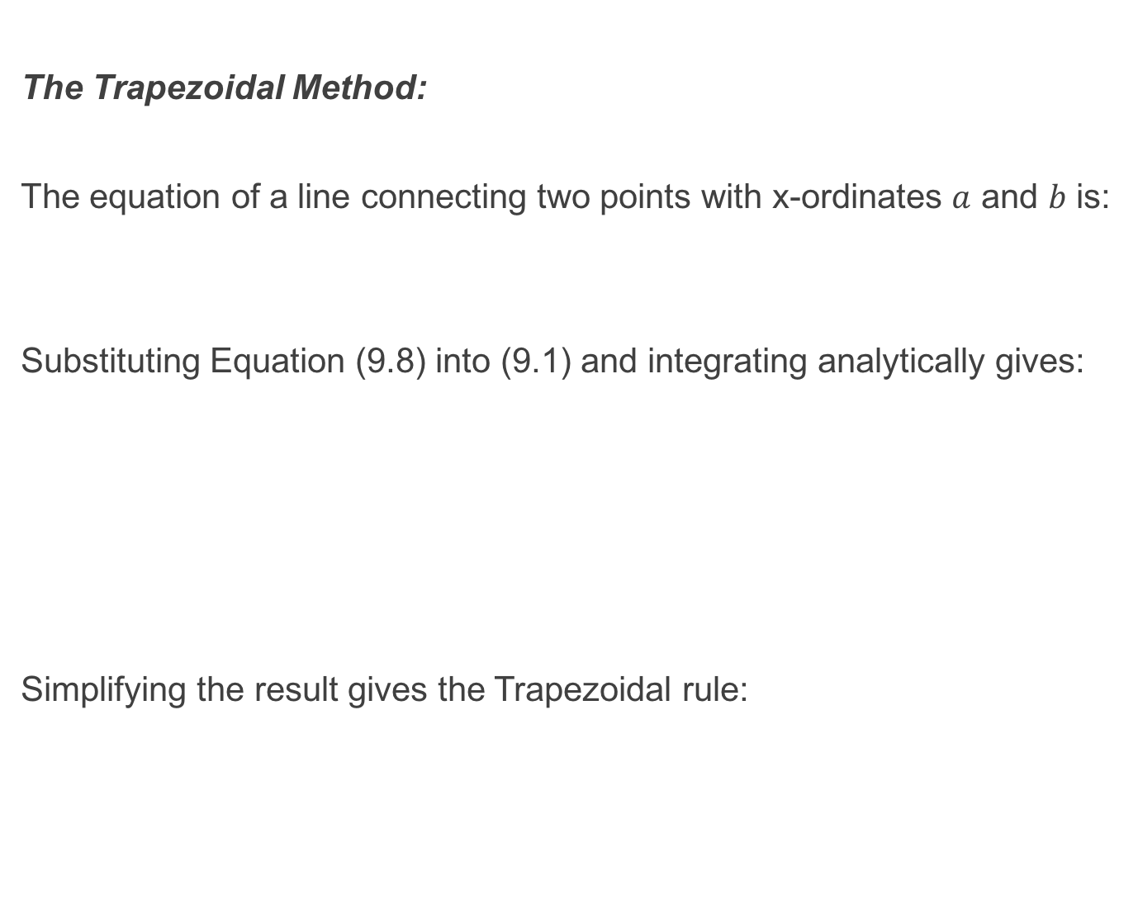
The Trapezoidal Method:
The equation of a line connecting two points with x-ordinates $a$ and $b$ is:
Substituting Equation (9.8) into (9.1) and integrating analytically gives:
Simplifying the result gives the Trapezoidal rule:

Slide 15
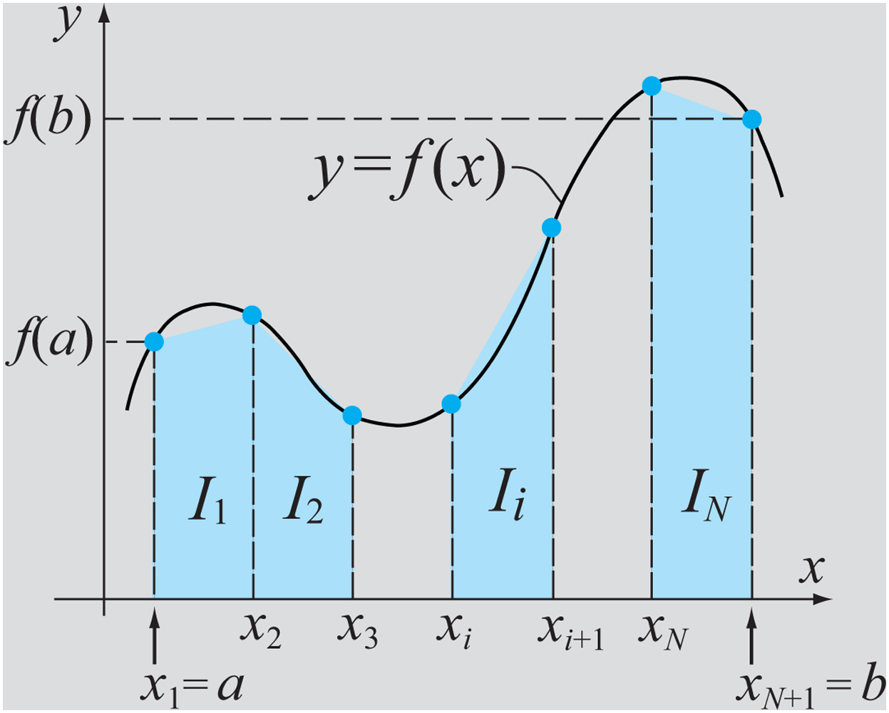
The Trapezoidal Method:
Again a more accurate result can be performed by composite integration yielding the Composite Trapezoidal Method:

Slide 16
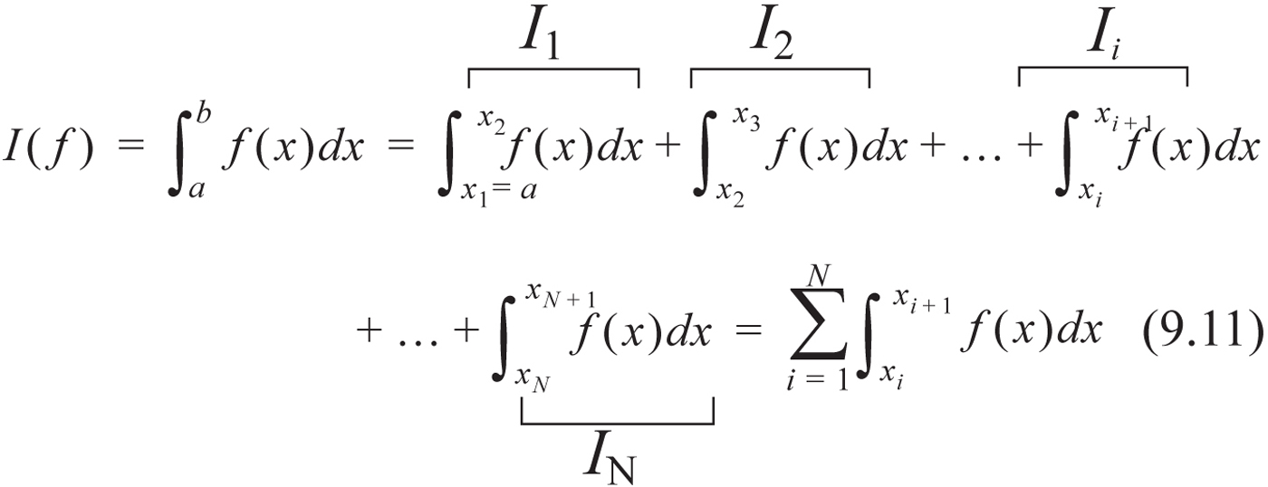
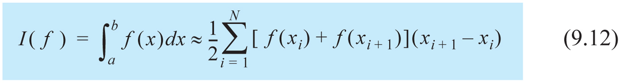
The Trapezoidal Method:
Mathematically:
Applying the Trapezoidal Method to each subinterval yields:

Slide 17
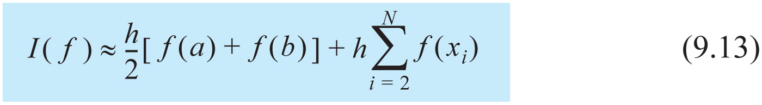
The Trapezoidal Method:
With equally sized subintervals this can be reduced to:

Slide 18
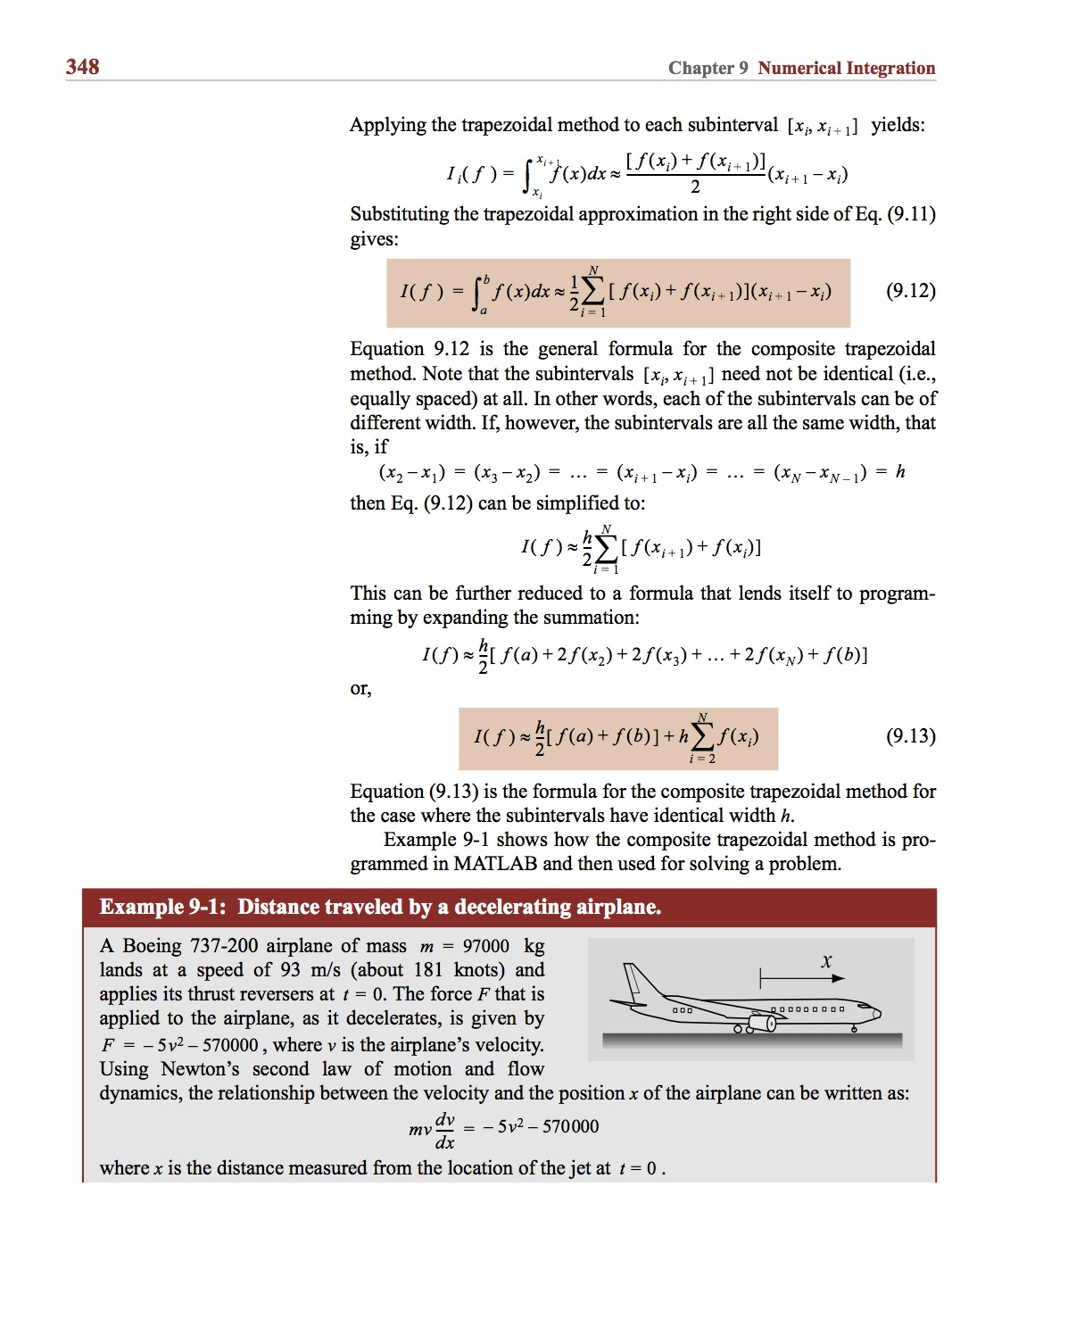
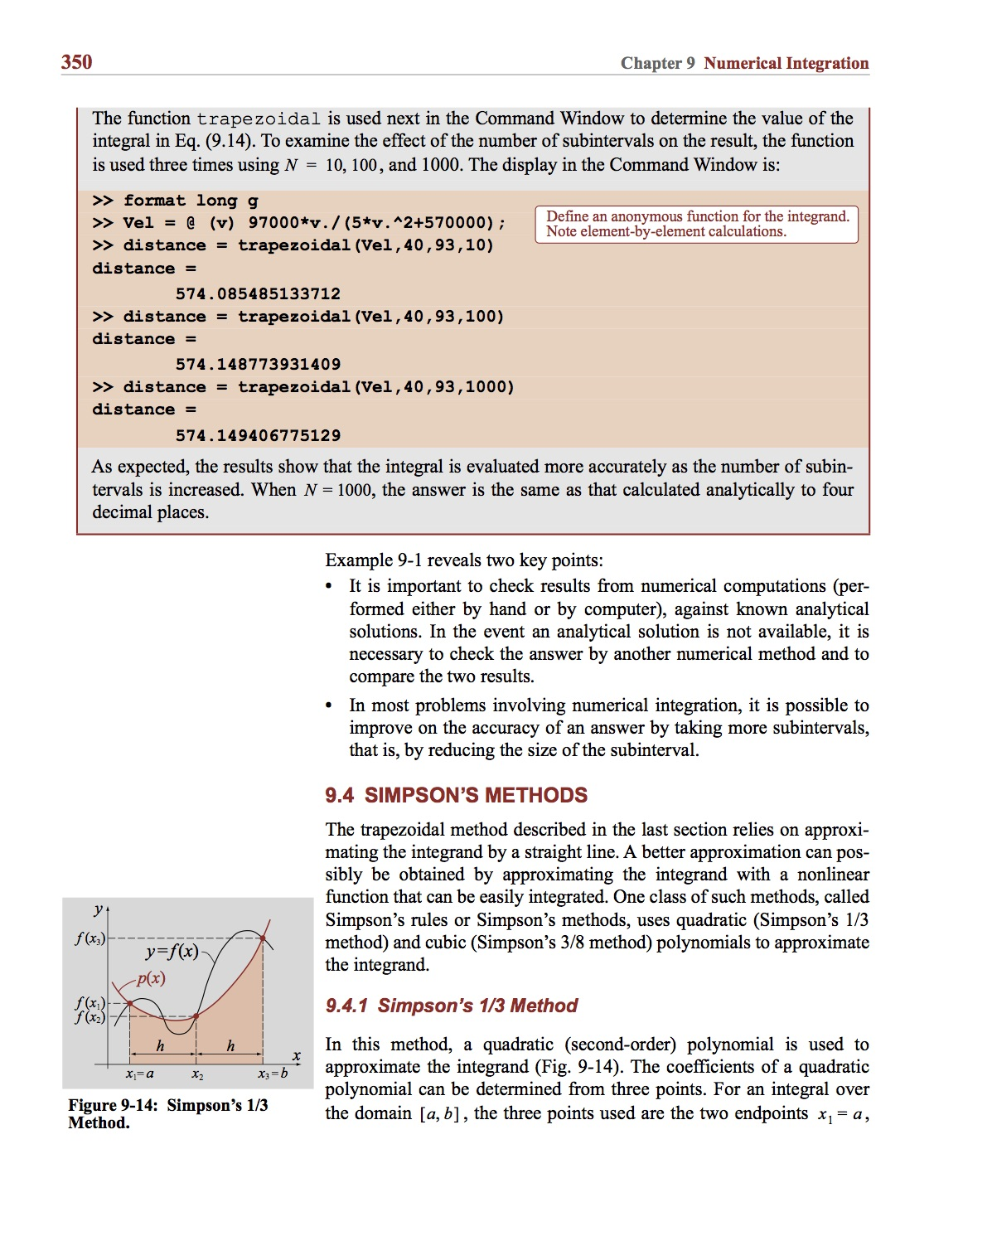
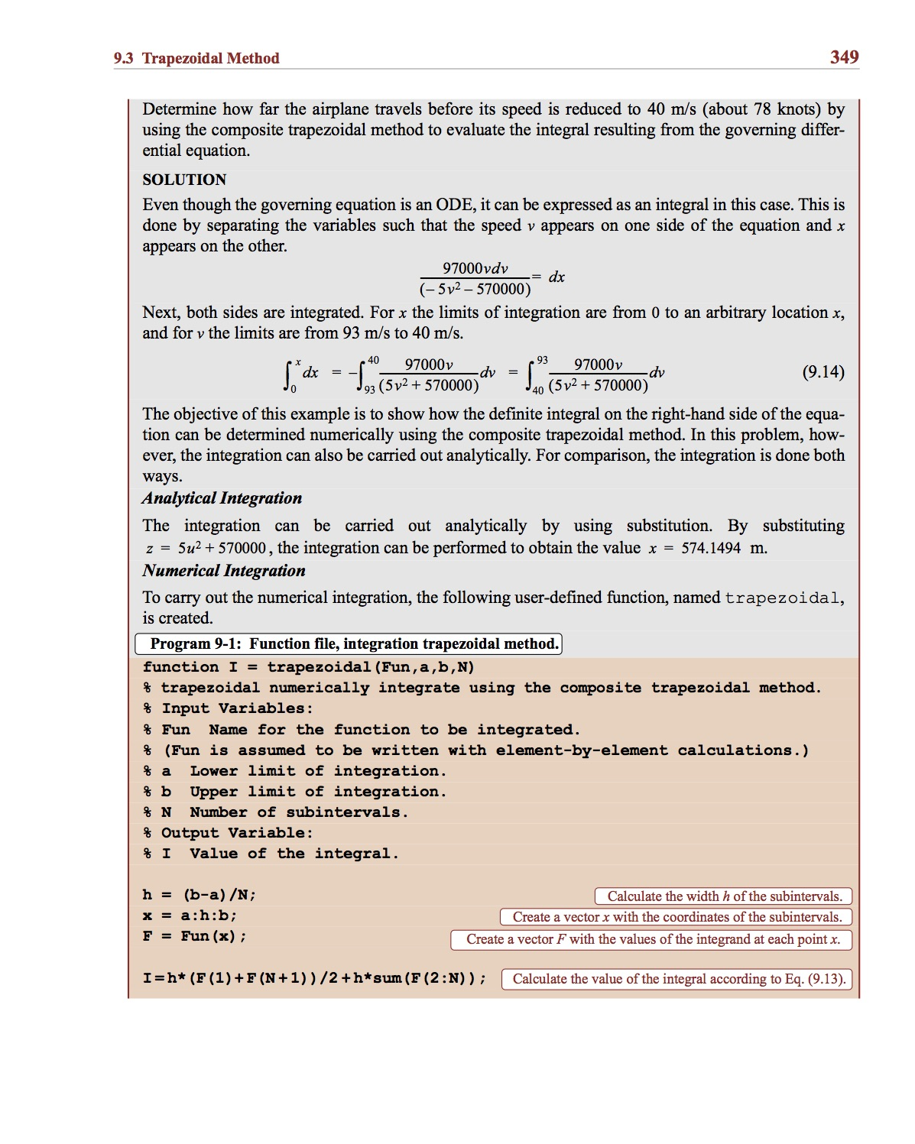
Example:

Slide 19
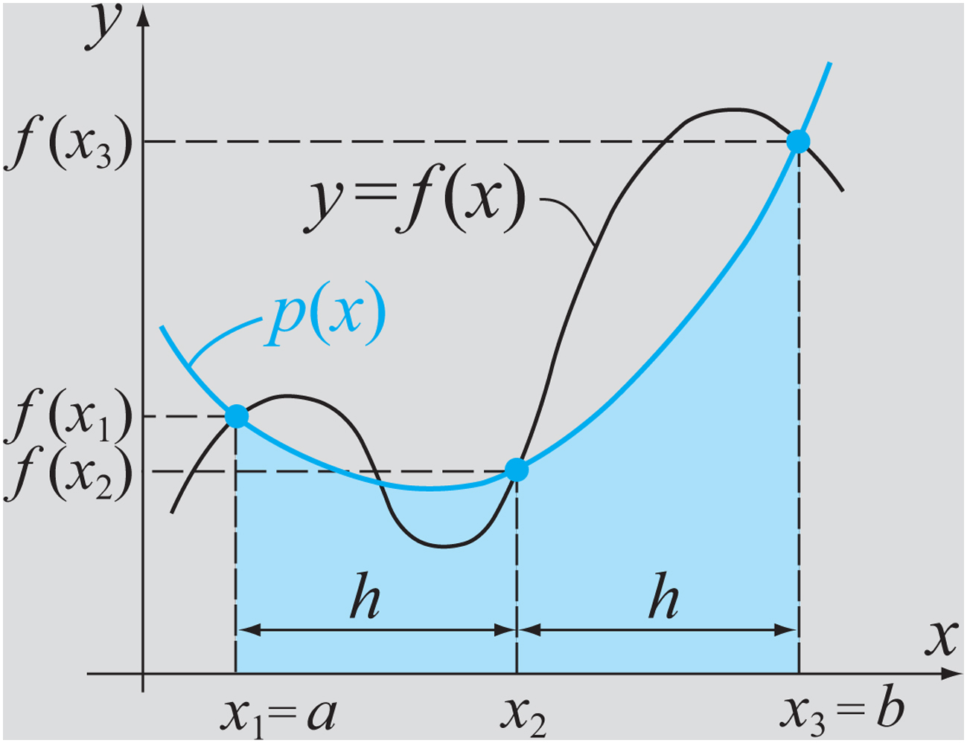
Simpson’s Methods:
With Simpson’s Methods the integrand is approximated by a quadratic or cubic polynomial.

Slide 20
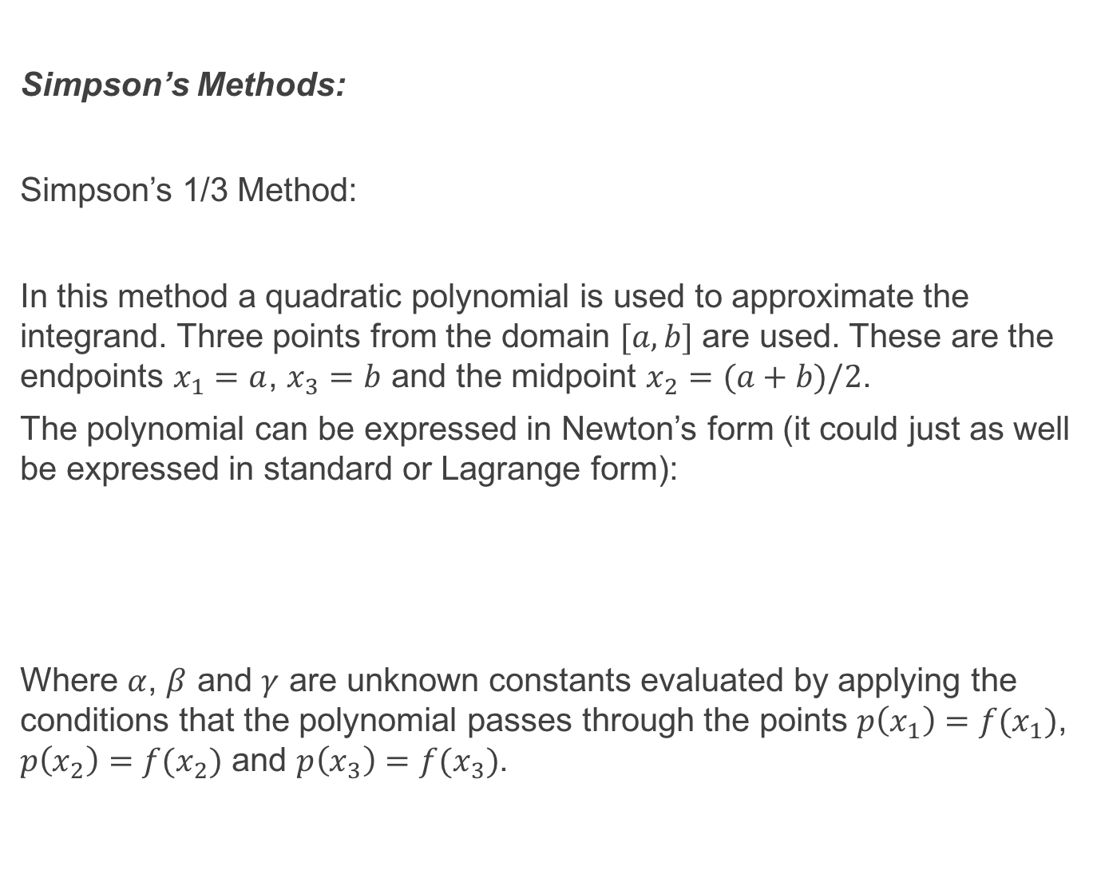
Simpson’s Methods:
Simpson’s 1/3 Method:
In this method a quadratic polynomial is used to approximate the integrand. Three points from the domain $[a, b]$ are used. These are the endpoints $x_{1}=a$, $x_{3}=b$ and the midpoint $x_{2}=(a+b)/2$.
The polynomial can be expressed in Newton’s form (it could just as well be expressed in standard or Lagrange form):
Where $α$, $β$ and $γ$ are unknown constants evaluated by applying the conditions that the polynomial passes through the points $p\left(x_{1}\right)=f(x_{1})$, $p\left(x_{2}\right)=f(x_{2})$ and $p\left(x_{3}\right)=f(x_{3})$.

Slide 21
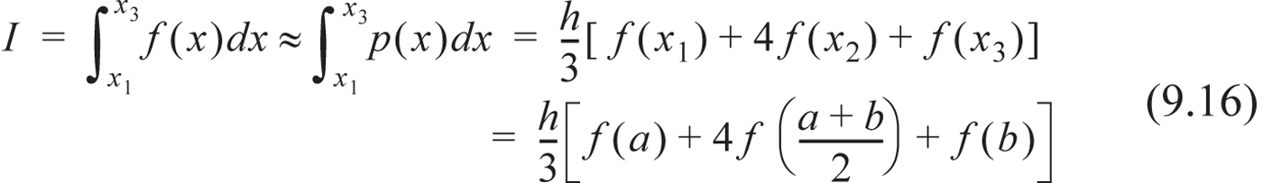
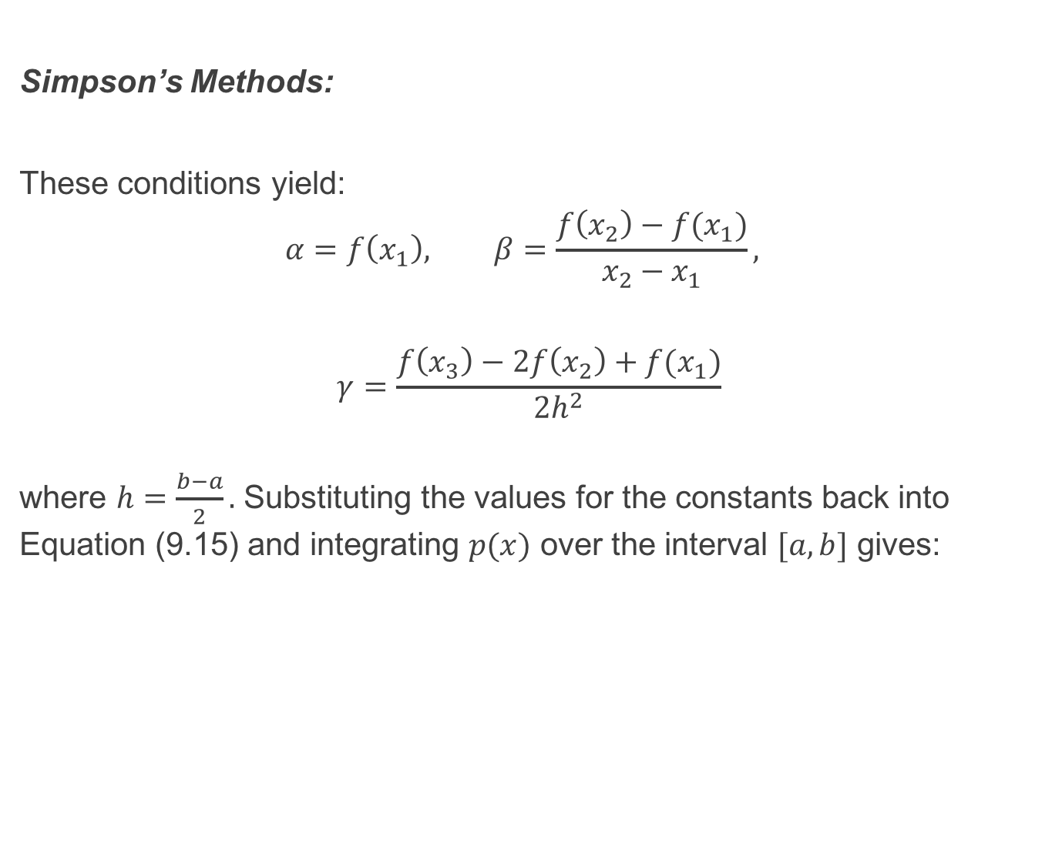
Simpson’s Methods:
These conditions yield:
$$α=f\left(x_{1}\right), β=\frac{f\left(x_{2}\right)−f(x_{1})}{x_{2}−x_{1}},$$
$$γ=\frac{f\left(x_{3}\right)−2f\left(x_{2}\right)+f(x_{1})}{2h^{2}}$$
where $h=\frac{b−a}{2}.$ Substituting the values for the constants back into Equation (9.15) and integrating $p(x)$ over the interval $[a, b]$ gives:

Slide 22
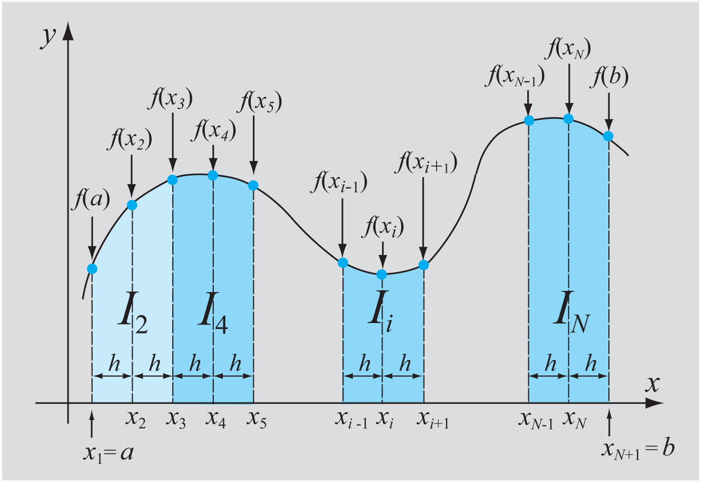
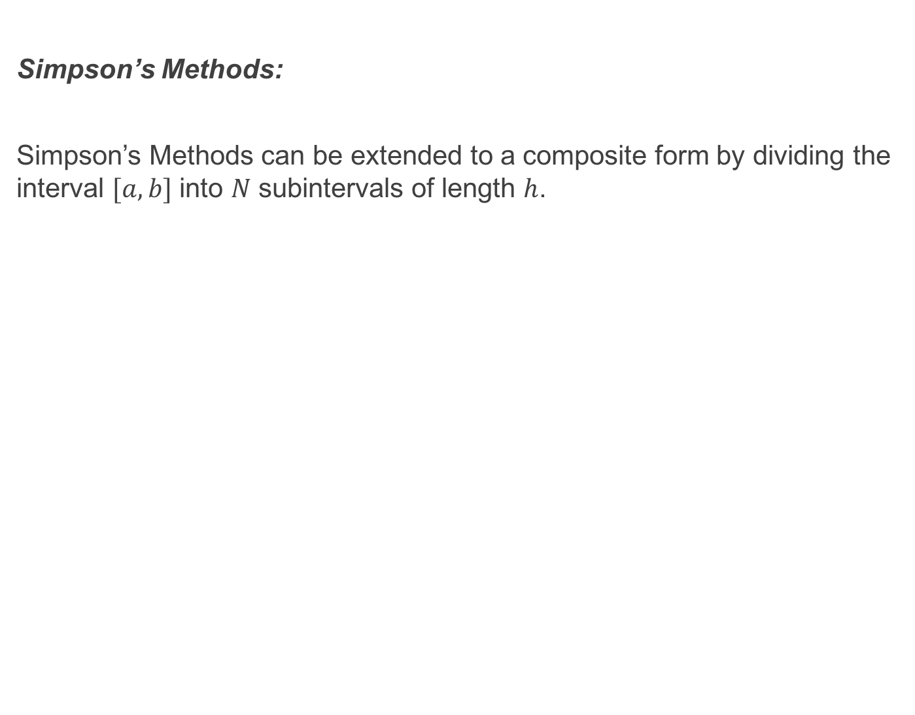
Simpson’s Methods:
Simpson’s Methods can be extended to a composite form by dividing the interval $[a, b]$ into $N$ subintervals of length $h$.

Slide 23
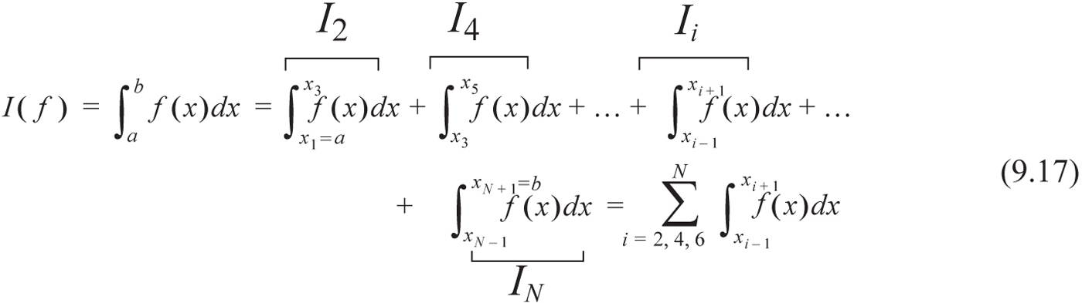
Simpson’s Methods:
Since Simpson’s 1/3 Method is applied to two subintervals at a time it is necessary that the total number of subintervals is even. The integral over the whole interval is then written:

Slide 24
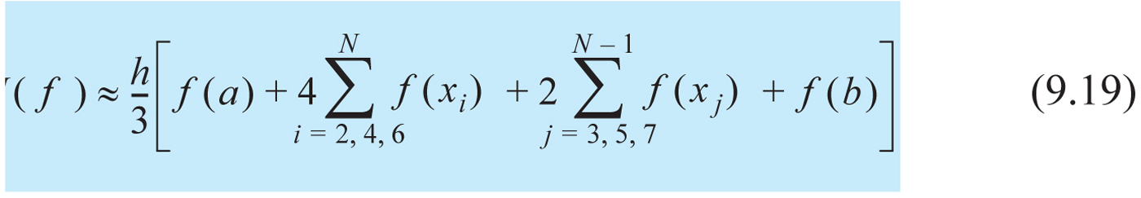
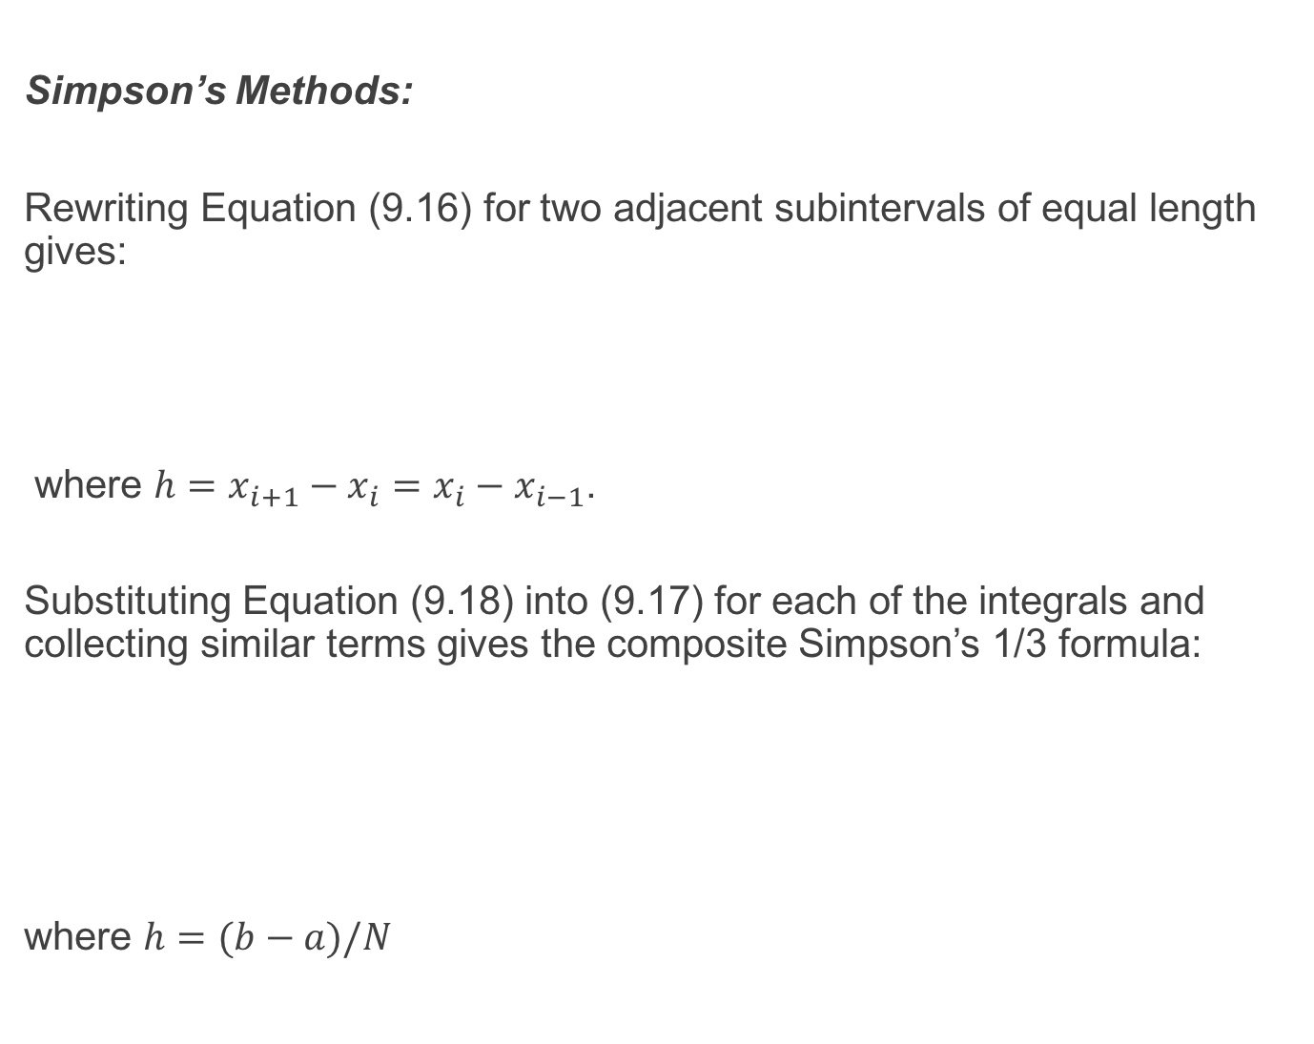
Simpson’s Methods:
Rewriting Equation (9.16) for two adjacent subintervals of equal length gives:
where $h=x_{i+1}−x_{i}=x_{i}−x_{i−1}$.
Substituting Equation (9.18) into (9.17) for each of the integrals and collecting similar terms gives the composite Simpson’s 1/3 formula:
where $h=(b−a)/N$

Slide 25
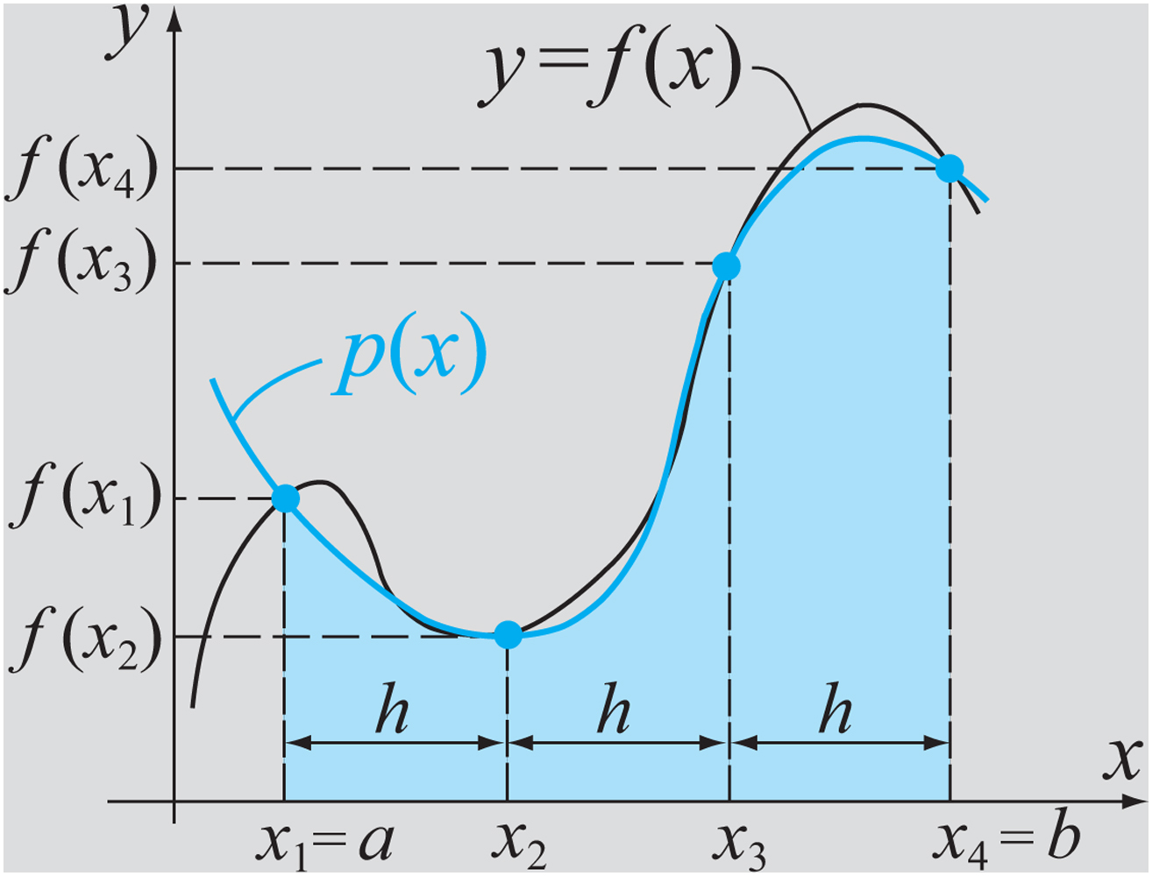
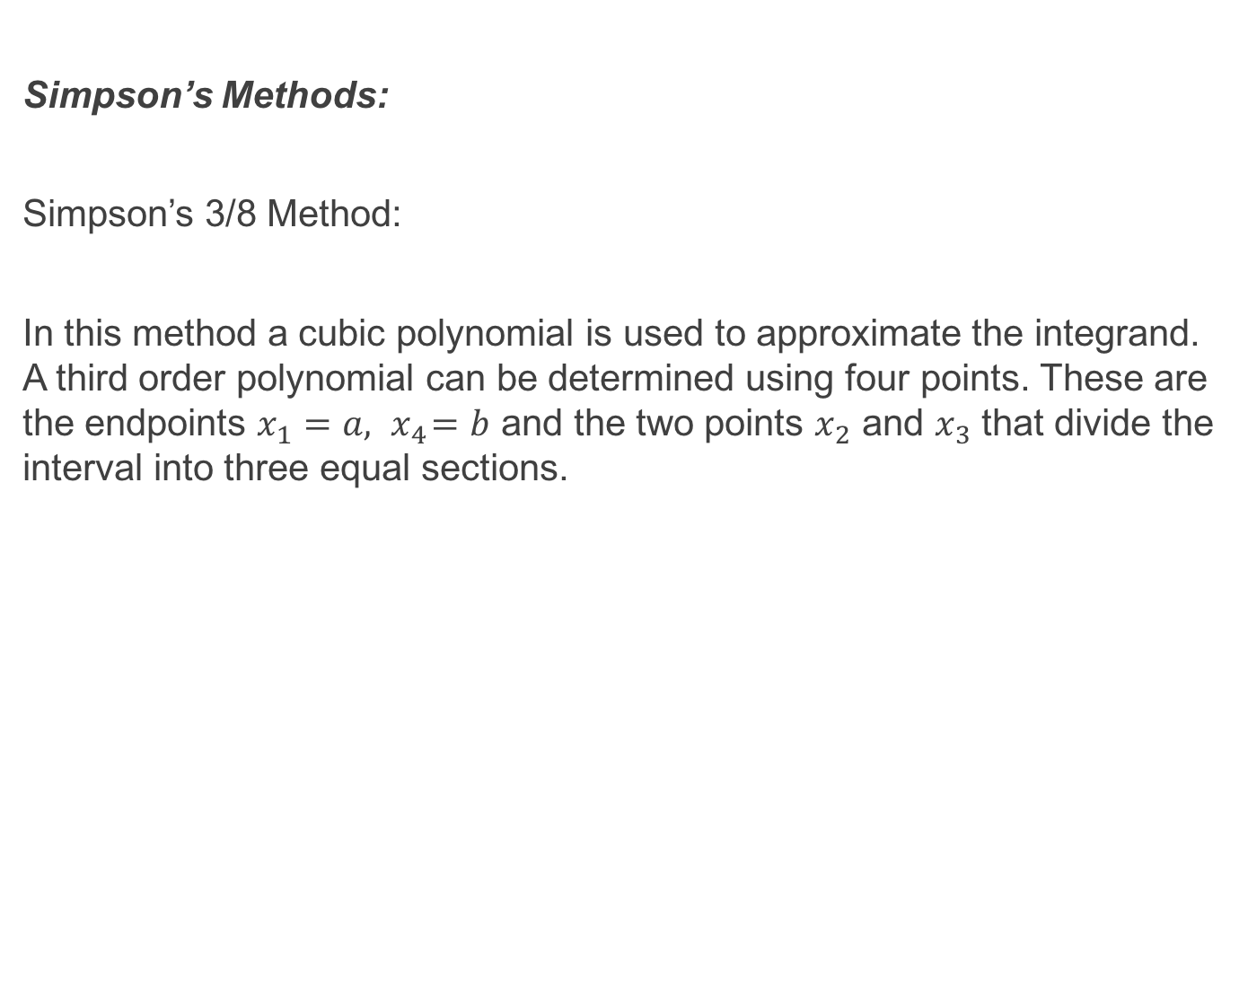
Simpson’s Methods:
Simpson’s 3/8 Method:
In this method a cubic polynomial is used to approximate the integrand. A third order polynomial can be determined using four points. These are the endpoints $x_{1}=a, { x}_{4}=b$ and the two points $x_{2}$ and $x_{3}$ that divide the interval into three equal sections.

Slide 26
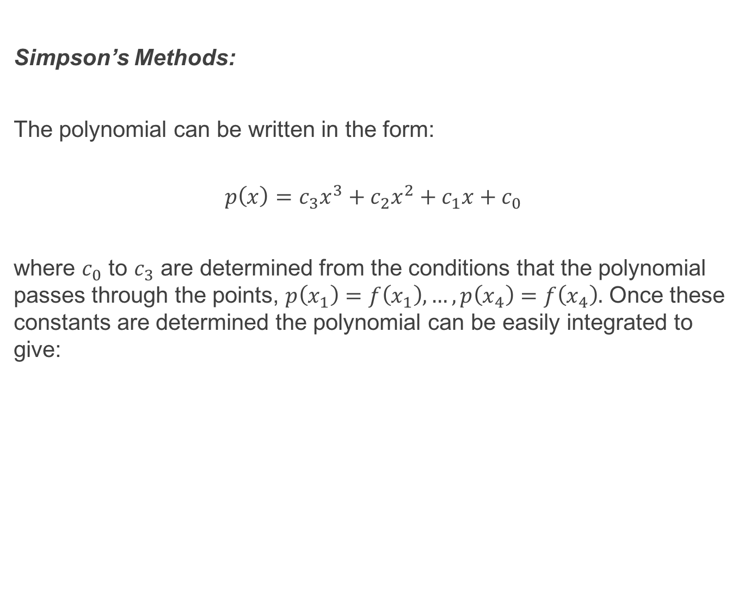
Simpson’s Methods:
The polynomial can be written in the form:
$$p\left(x\right)=c_{3}x^{3}+c_{2}x^{2}+c_{1}x+c_{0}$$
where $c_{0}$ to $c_{3}$ are determined from the conditions that the polynomial passes through the points, $p\left(x_{1}\right)=f\left(x_{1}\right), …, p\left(x_{4}\right)=f\left(x_{4}\right).$ Once these constants are determined the polynomial can be easily integrated to give:

Slide 27
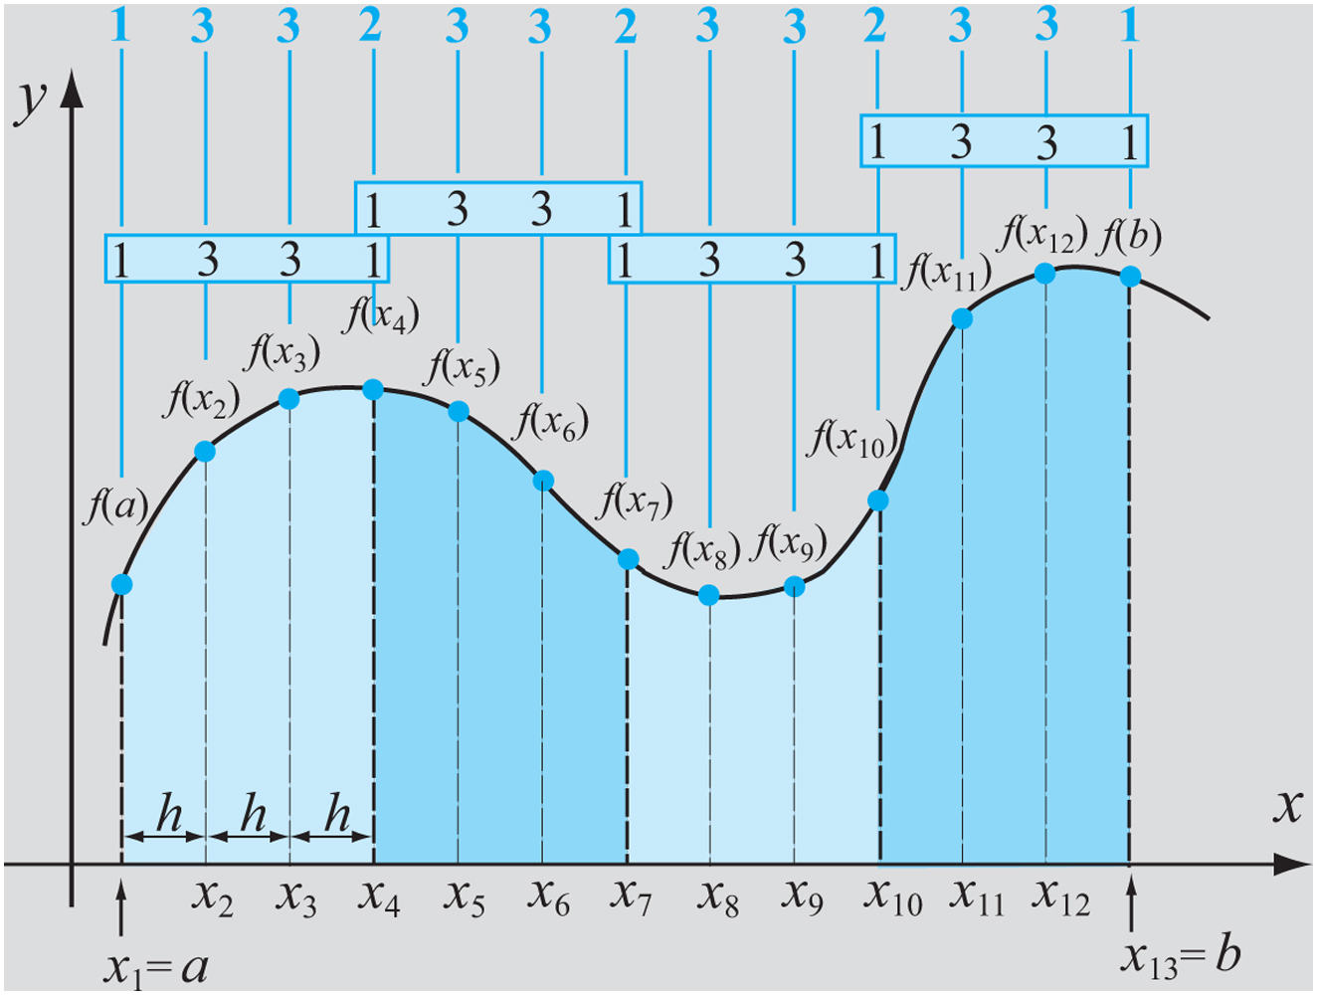
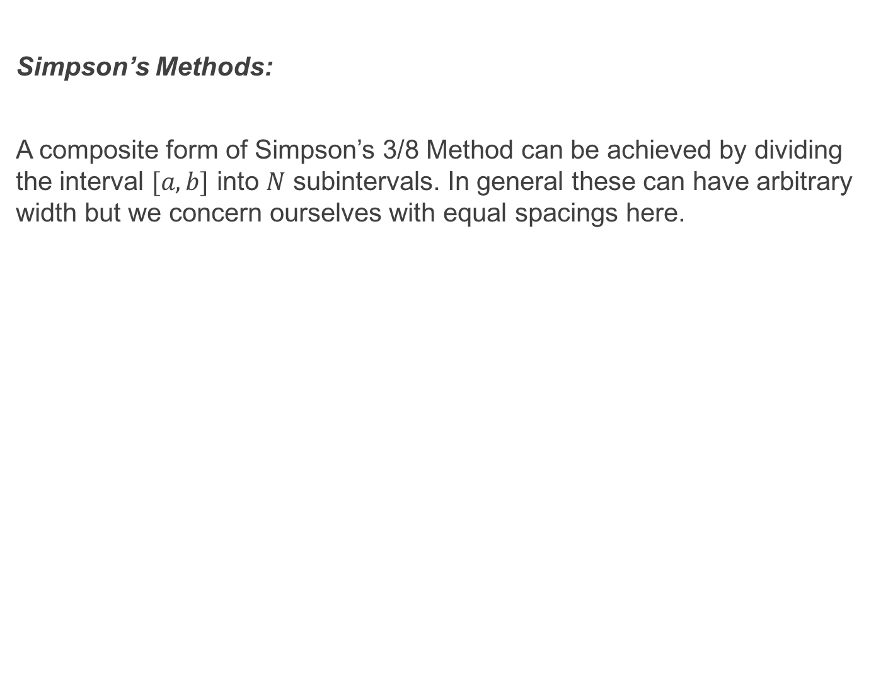
Simpson’s Methods:
A composite form of Simpson’s 3/8 Method can be achieved by dividing the interval $[a, b]$ into $N$ subintervals. In general these can have arbitrary width but we concern ourselves with equal spacings here.

Slide 28
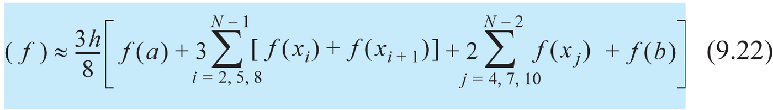
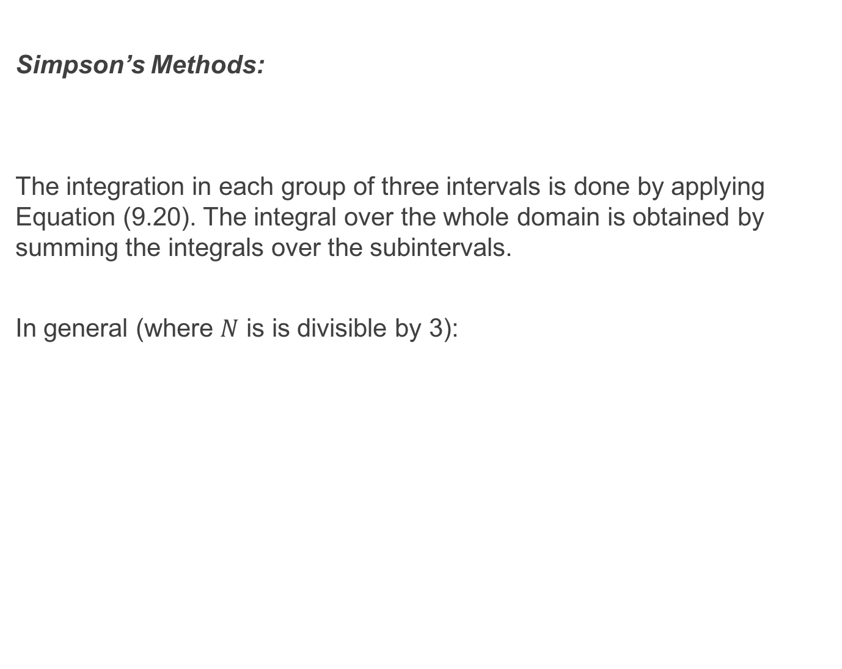
Simpson’s Methods:
The integration in each group of three intervals is done by applying Equation (9.20). The integral over the whole domain is obtained by summing the integrals over the subintervals.
In general (where $N$ is is divisible by 3):

Slide 29
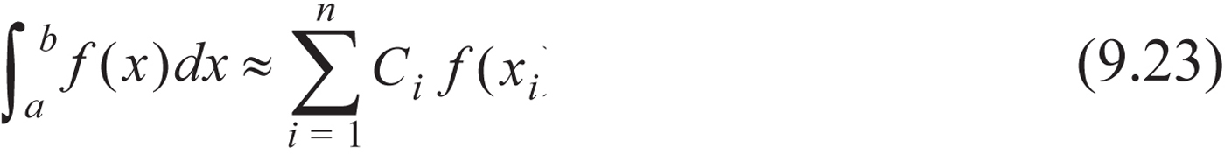
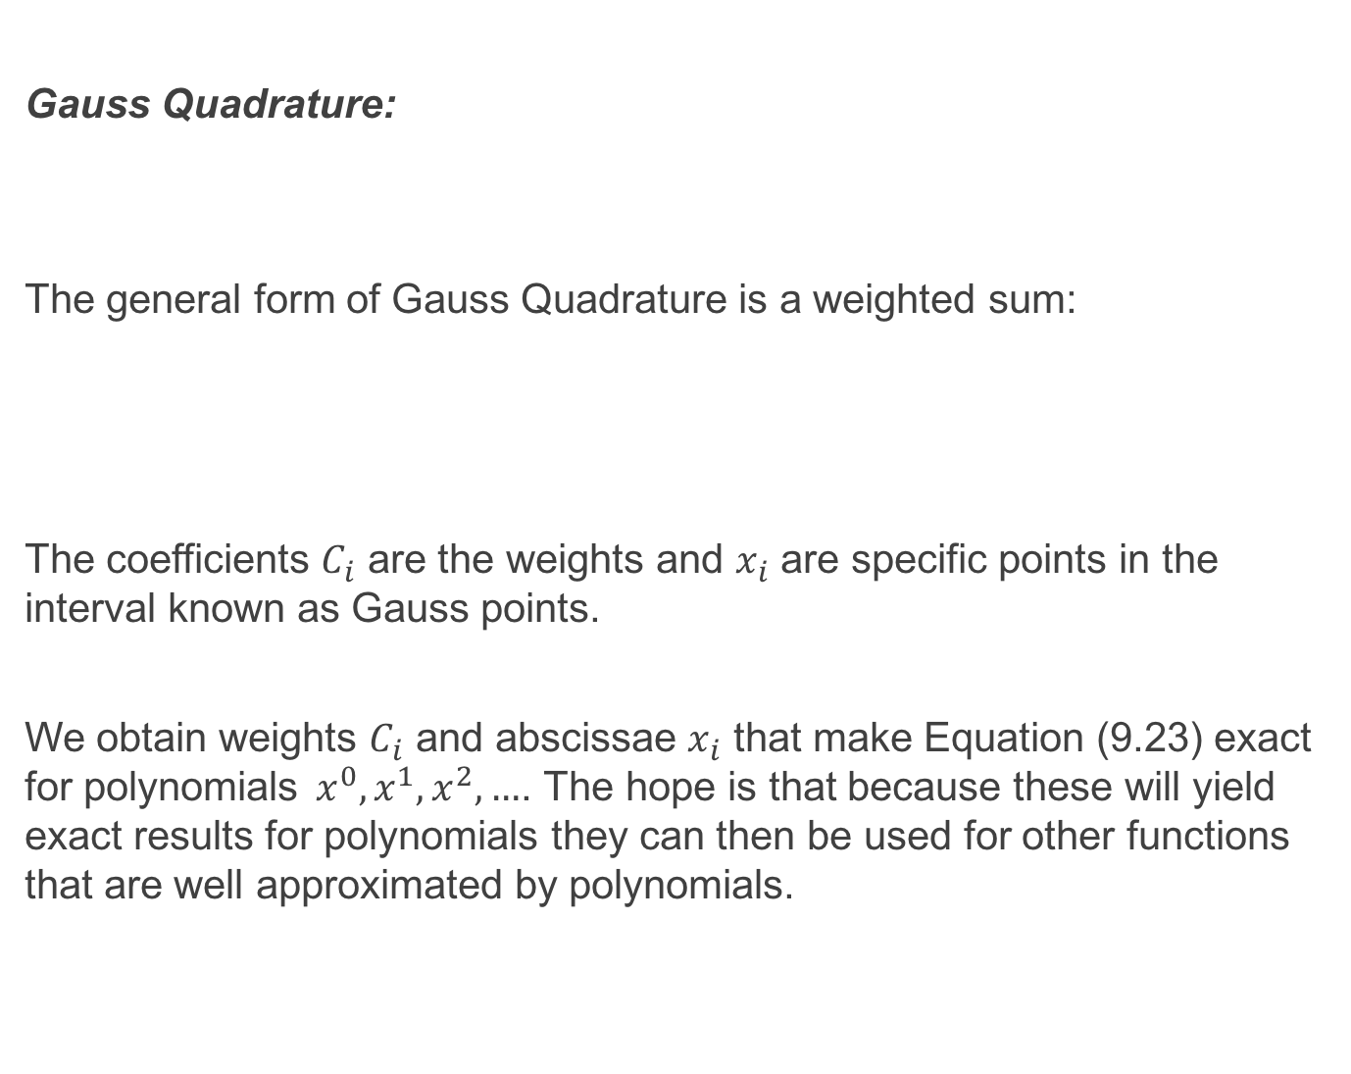
Gauss Quadrature:
The general form of Gauss Quadrature is a weighted sum:
The coefficients $C_{i}$ are the weights and $x_{i}$ are specific points in the interval known as Gauss points.
We obtain weights $C_{i}$ and abscissae $x_{i}$ that make Equation (9.23) exact for polynomials${ x}^{0}, x^{1}, x^{2}, …$. The hope is that because these will yield exact results for polynomials they can then be used for other functions that are well approximated by polynomials.

Slide 30


Gauss Quadrature:
Beginning with the domain $[−1, 1]$ the form of Gauss quadrature is:
We now force Equation (9.24) to be exact for the cases where $f\left(x\right)=1, x, x^{2}, x^{3}$, … . The number of cases that have to be considered depends on $n.$ For example when $n=2$ we need to determine four values:

Slide 31

Gauss Quadrature:
The four constants $C_{1}, C_{2}, x_{1}$ and $x_{2}$ are determined by enforcing Equation (9.25) to be exact when applied to the following four cases:
Case 1: $f\left(x\right)=1$ $\int_{−1}^{1}{\left(1\right)dx=2=C_{1}+C_{2}}$
Case 2: $f\left(x\right)=x$ $\int_{−1}^{1}{xdx=0=C_{1}x_{1}+C_{2}x_{2}}$
Case 3: $f\left(x\right)=x^{2}$ $\int_{−1}^{1}{x^{2}dx=\frac{2}{3}=C_{1}x_{1}^{2}+C_{2}x_{2}^{2}}$
Case 4: $f\left(x\right)=x^{3}$ $\int_{−1}^{1}{x^{3}dx=0=C_{1}x_{1}^{3}+C_{2}x_{2}^{3}}$

Slide 32


Gauss Quadrature:
This is a system of four equations with four unknowns so we can solve for $C_{1}, C_{2}, x_{1}$ and $x_{2}$. However since the equations are nonlinear multiple solutions can exist. A particular solution can be obtained by imposing the condition that $x_{1}$ and $x_{2}$ are symmetrically located about $x=0$ i.e. $x_{1}=−x_{2}$. This requirement implies that $C_{1}=C_{2}$. Solving gives:
$$C_{1}=C_{2}=1, x_{1}=−\frac{1}{\sqrt{3}}, { x}_{2}=\frac{1}{\sqrt{3}}$$
Substituting back into Equation (9.25) gives (for $n=2$):
This equation is exact for $f\left(x\right)=1, f\left(x\right)=x, f\left(x\right)=x^{2}$ and $f\left(x\right)=x^{3}$.

Slide 33

Gauss Quadrature:
Example:
Let $f\left(x\right)=\cos{x}$.
$$\int_{−1}^{1}{\cos{x dx}={\left.\sin{x}\right|}_{−1}^{1}}=\sin\left(1\right)− \sin\left(−1\right)=1.68294197$$
The approximate value using Gauss quadrature is:
$$\cos\left(\frac{−1}{\sqrt{3}}\right)+\cos\left(\frac{1}{\sqrt{3}}\right)=1.67582366$$
This error is within 4.5% of the exact solution.

Slide 34

Gauss Quadrature:
The accuracy of Gauss quadrature is increased by using a higher value of $n$. For $n=3$ the equation has the form:
In this case six values have to be determined: $C_{1}, C_{2}, C_{3}$ and $x_{1}, x_{2}, x_{3}.$
The values are determined as before by forcing Equation (9.28) to be exact when $f\left(x\right)=1, f\left(x\right)=x, f\left(x\right)=x^{2}, …, f\left(x\right)=x^{5}$. This results in a set of six equations with six unknowns. The values that are determined are given in the following table for this and a number of points up to $n=6.$

Slide 35

Gauss Quadrature:
The general formula to use in conjunction with the table for Gauss quadrature is:

Slide 36

Gauss Quadrature:
Evaluating $\int_{−1}^{1}{\cos{x} dx}$ again using Gauss quadrature with three points we get:
$$\int_{−1}^{1}{\cos{x}} dx$$
$$≈0.5555556cos\left(−0.77459667\right)+0.8888889cos\left(0\right)+0.5555556cos\left(0.77459667\right)$$
$$=1.68285982$$
This is an almost exact result.

Slide 37

Gauss Quadrature:
When the domain of integration is not $[−1, 1]$ then a change of variables is necessary. In other words the integral $\int_{a}^{b}{f\left(x\right)dx −>\int_{−1}^{1}{g\left(t\right)dt.}}$
The change in variable is:
The Gauss quadrature is then performed using the transformed integral.

Slide 38

Example:

Slide 39

Improper Integrals:
So far we have considered integrals of well behaved functions with finite limits. Situations arise however where functions are not well behaved (discontinuous or singular) and/or have infinite limits.
Integrals with Singularities:
If the integral $\int_{a}^{b}{f\left(x\right)dx }$is singular at $x=c∈[a,b]$ then the integration can be performed over two intervals $[a,c]$ and $[c,b]$. Mathematically integrals that have a singularity at one of the endpoints may or may not have a finite value. For example the function $1/\sqrt{x}$ is singular at $x=0$ but the integral of the function over $[0,2]$ has a value of 2. That is: $\int_{0}^{1}{\frac{1}{\sqrt{x}}dx=2}$. An estimate of the integral can be obtained using any of the methods described here that do not use endpoints e.g. composite midpoint or Gauss quadrature. Otherwise we can choose points very close to the endpoints that do not include the singularity and integrate over this domain. On the other hand $\int_{0}^{1}{\frac{1}{x}dx}$ does not have a finite value (i.e. $=∞).$

Slide 40

Improper Integrals:
Integrals with Unbounded Limits:
Again integrals with infinite limits can converge (have a finite value) or may diverge (have an infinite value). In the case of the former the integration can be performed over a finite domain where the function has values that are not close to zero. This is a typical situation where the integrand has a finite value over a relatively small domain and close to zero everywhere else. An example is the Gaussian pdf in statistics:
$$\int_{−∞}^{b}{\frac{1}{\sqrt{2π}}}e^{\left(\frac{−x^{2}}{2}\right)}dx$$
The computation of the integral stops where successive iterations yield only a small (tolerable) change in the result.

Slide 41
Recommended Problems:
Problems to be solved by hand (do at least 2):
9.1(approx. 3.1), 9.5 (approx. 0.54 – 0.6), 9.7, 9.10 (1474.7 ft)
Problems to be programmed in MATLAB:
9.23, 9.26
Problems in Science and Engineering (do at least 1):
9.30(b), 9.35
You should pick out problems that you find interesting/challenging and do these too.

